Slide 1
National Nutrition Month® 2025
NationalNutritionMonth.org
Notes:
Hello, my name is ___________________________, and I am a ________________________ (RDN, NDTR, intern, etc.).
I’m also a member of the Academy of Nutrition and Dietetics (Academy), the world’s largest organization of food and nutrition professionals.
Members of the Academy, including registered dietitian nutritionists (RDNs) and nutrition and dietetics technicians, registered (NDTRs), play a key role in shaping the public's food choices and are committed to improving the nation’s health.
As food and nutrition experts, RDNs serve in roles that have a positive impact on the health of their patients, clients and communities. RDNs offer preventive and medical nutrition therapy services in a variety of settings, and they are a trusted source about what types of food to eat.
NDTRs are also employed throughout the community in areas such as hospitals, public health clinics, nursing homes and more and use their nutrition knowledge to help people make positive lifestyle changes.

Slide 2
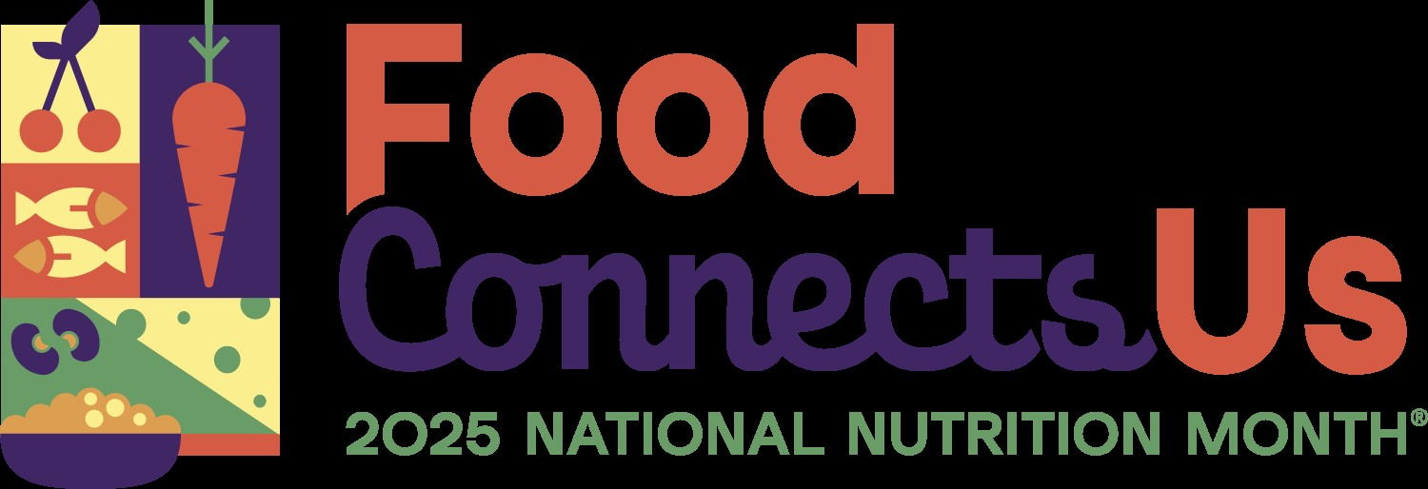
NationalNutritionMonth.org
Notes:
Each year during March, we celebrate National Nutrition Month®, which is a nutrition education and information campaign sponsored by the Academy. It invites everyone to learn about making informed food choices and developing sound eating and physical activity habits.
National Nutrition Month® started in 1973 as National Nutrition Week, and it became a month-long observance in 1980 in response to growing interest in nutrition.
The theme for National Nutrition Month® 2025 is Food Connects Us, which highlights the connection between health, access, traditions and food across all stages of life.

Slide 3
Objectives
Identify at least two ways in which Food Connects Us.
Explain what foods make up a healthy eating pattern.
Describe ways to explore the connection between food and culture.
Notes:
At the end of today’s presentation, you will be able to:
Identify at least two ways in which Food Connects Us.
Explain what foods make up a healthy eating pattern.
Describe ways to explore the connection between food and culture.

Slide 4
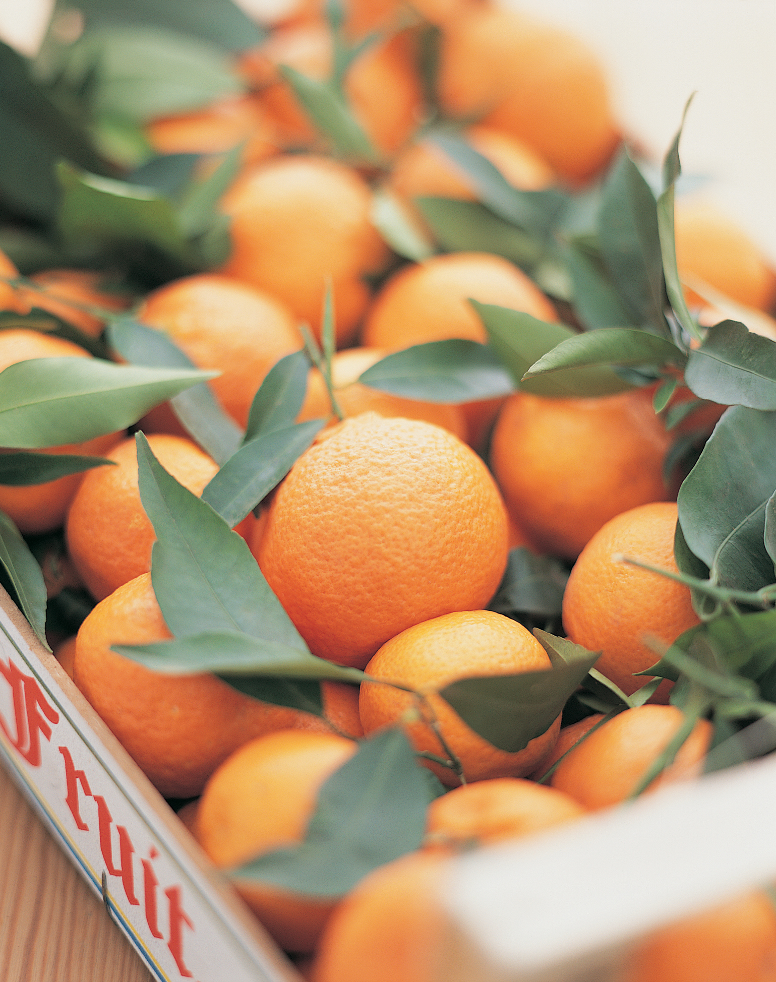
Connect with Food.
Learn cooking, food preparation and meal planning skills.
Explore where your food comes from.
Learn about community resources such as SNAP, WIC and local food banks.
NationalNutritionMonth.org
Notes:
Food offers many connections throughout life, as we’ll be discussing during this presentation.
To start, a few ways to Connect with Food include:
Learning cooking, food preparation and meal planning skills.
Exploring where your food comes from.
Learning about community resources such as SNAP, WIC and local food banks.
Can anyone think of other ways to Connect with Food?
Preparing foods at home allows you to control the ingredients, their amounts and how the foods are made. By learning cooking, food preparation and meal planning skills, you can identify ways to substitute lower cost ingredients, use lesser amounts in some cases, and increase the nutrition of many dishes by including more fruits and vegetables.
Exploring where your food comes offers you the opportunity to learn how it was grown or raised. It may even inspire you to start a home or community garden.
Food assistance programs like SNAP, WIC, and local food banks may also be available to individuals who are eligible.

Slide 5

Food Connects Us
to Health
NationalNutritionMonth.org
Notes:
We may not think about this until we get older, but food also connects us to health.
Many factors influence our relationship with food, including health, as well as memories, traditions, seasons and access to food.
While these factors influence the foods we eat, the foods we eat also affect our health. The good news is that we’re never too young or too old to form healthier eating habits.
During our lives, foods may be recommended to help reduce the risk of certain chronic diseases or be prescribed in the treatment of some health conditions.

Slide 6
Healthy Eating Patterns
Include:
  Vegetables
  Fruits
  Grains, especially whole grains
  Lean protein foods
  Low-fat or fat-free dairy or fortified soy versions
Limit:
  Added sugars
  Saturated fat
  Sodium
NationalNutritionMonth.org
Notes:
In fact, there is a lot of research linking a healthy eating pattern, which consists of fruits, vegetables, whole grains, lean protein foods, and dairy or fortified soy versions, while also limiting saturated fat, sodium, and added sugars with a reduced risk of diet-related chronic diseases, such as heart disease, Type 2 diabetes, and some types of cancer.
(Source: U.S. Department of Agriculture and U.S. Department of Health and Human Services. Dietary Guidelines for Americans, 2020-2025. 9th Edition. December 2020. Available at DietaryGuidelines.gov.)
RDNs and NDTRs play a critical role in helping people understand the connection between the foods individuals and communities eat, and how these foods impact health throughout life.

Slide 7

Connect with a Nutrition Expert.
Ask your doctor for a referral to an RDN.
Find an RDN who specializes in your unique needs.
Receive personalized nutrition information to meet your health goals.
NationalNutritionMonth.org
Notes:
So, connecting with a Nutrition Expert allows you to receive personalized nutrition information to meet your health goals.
RDNs provide preventive and medical nutrition therapy services, also called MNT, and specialize in different areas, such as diabetes.
MNT is a personalized, nutrition-based treatment plan that involves “assessing a person’s health status, medical history and eating patterns; identifying any dietary issues; and creating a personalized, culturally appropriate and medically supervised nutrition plan to treat or manage one or more health conditions”. (Source: https://www.eatrightpro.org/advocacy/initiatives/medical-nutrition-therapy-act/mnt-infographic)
RDNs are skilled at helping people adopt a healthy eating pattern that is mindful of their personal food and cultural preferences. (You may have to ask your doctor for a referral to an RDN.)

Slide 8

Find a Nutrition Expert at
eatright.org
Notes:
To find a Nutrition Expert who specializes in your unique needs in your area, visit the Academy of Nutrition and Dietetics’ website at www.eatright.org.

Slide 9
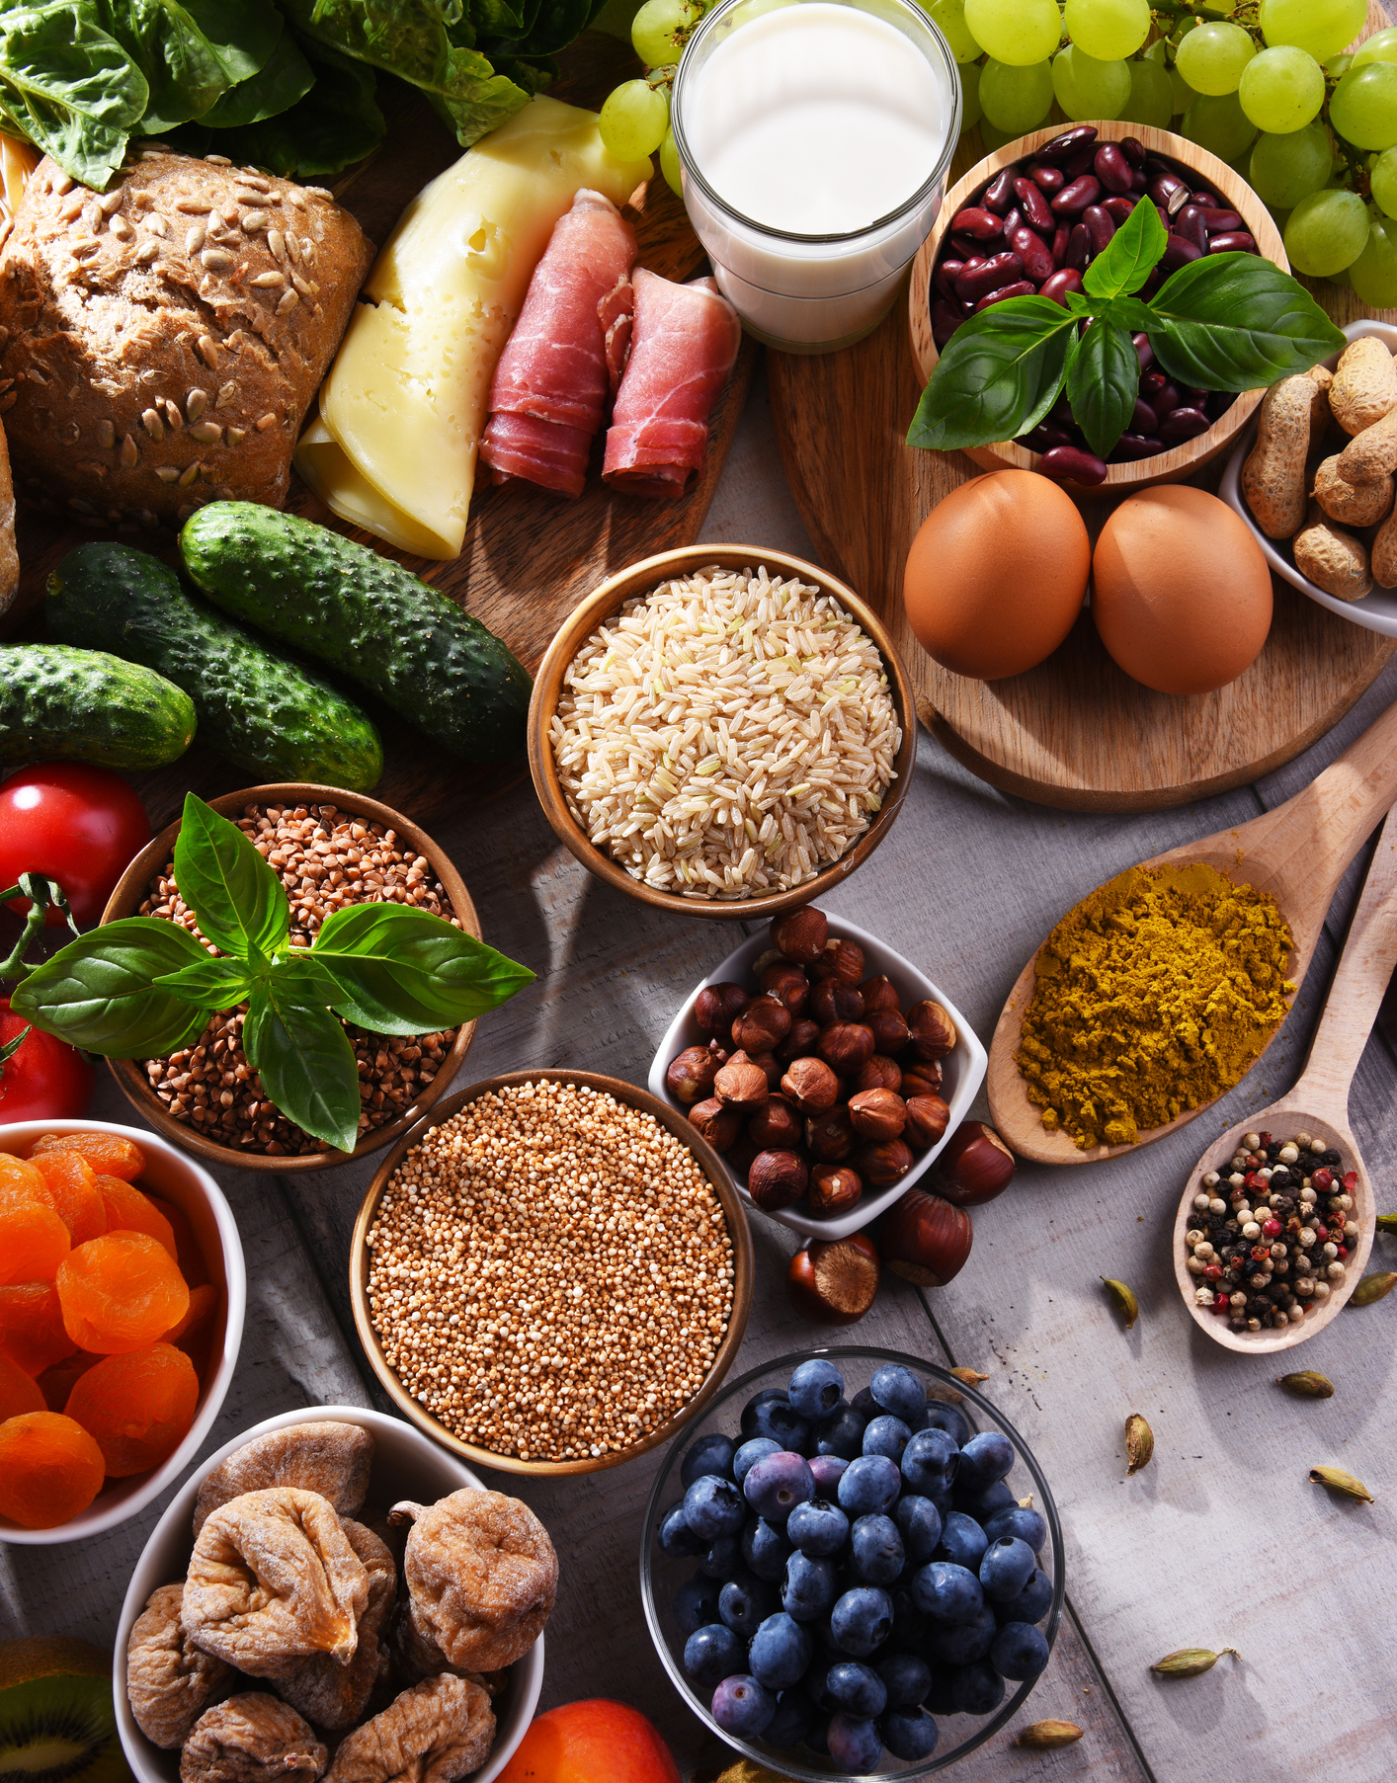

Food Connects Us to Our Culture
NationalNutritionMonth.org
Notes:
During National Nutrition Month®, you’re also encouraged to explore the connection between food and culture.
The foods we grow up eating are often influenced by our family’s culture. Do specific foods or celebrations come to mind? Would anyone like to share an example of foods that are special to your family’s traditions?

Slide 10
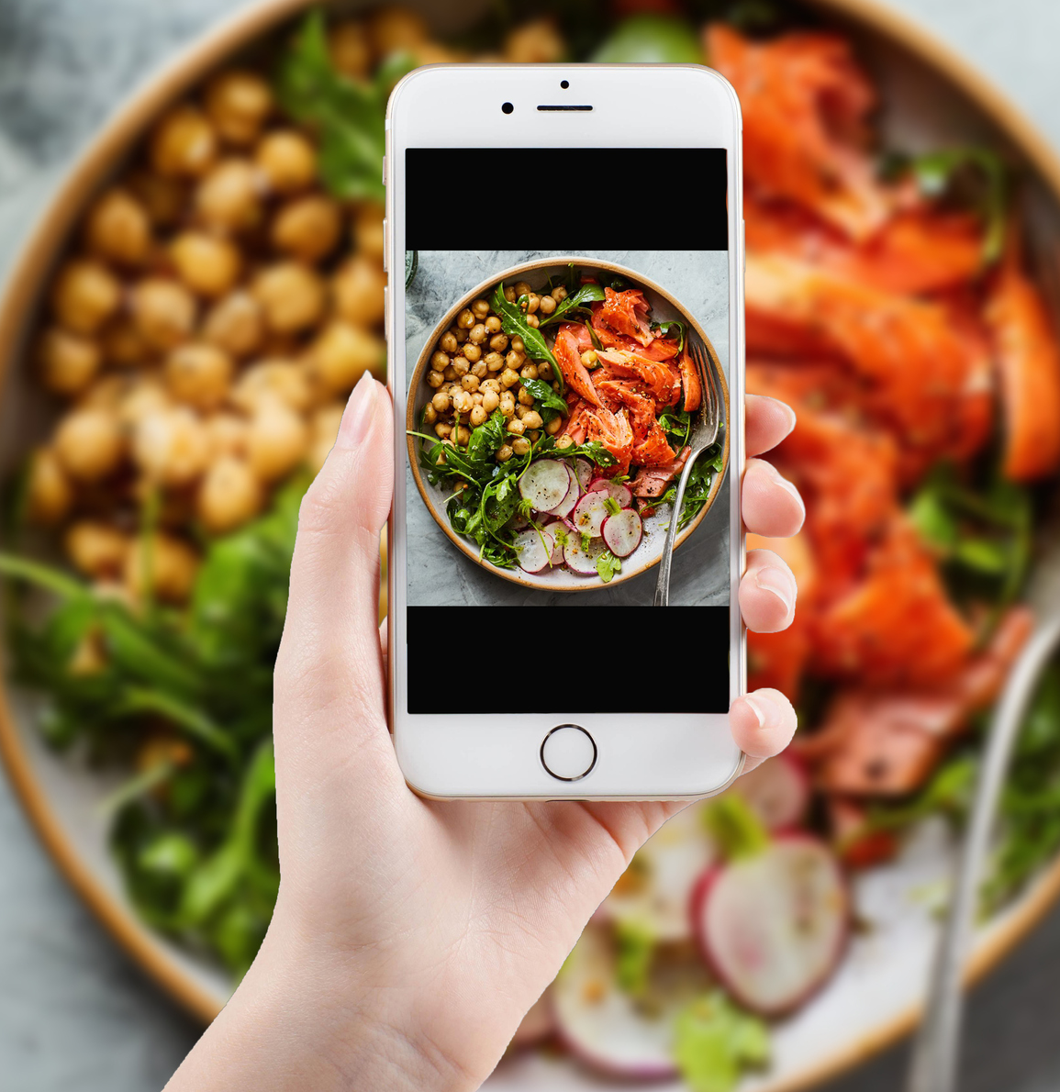
Explore the Connection Between Food and Culture.
Experiment with recipes using different ingredients or cooking techniques.
Include your favorite cultural foods and traditions or try new global flavors.
Enjoy your meals with family or friends, when possible.
NationalNutritionMonth.org
Notes:
Ways to explore the connection between food and culture include:
Experimenting with recipes using different ingredients or cooking techniques.
Including your favorite cultural foods and traditions or trying new global flavors.
Enjoying your meals with family or friends, when possible.
Although some ingredients can be unique to a specific culture, many of the same ingredients are common among various cuisines. However, the way the foods are prepared, their meaning, and the seasonings used may be different.
For example, beans and rice may feature red, black, or kidney beans. The rice could include white or brown rice, and the flavor can range from mild to spicy depending on the seasonings that are used. Can you think of other examples?
Would anyone like to share how they plan to explore the connection between food and culture?

Slide 11
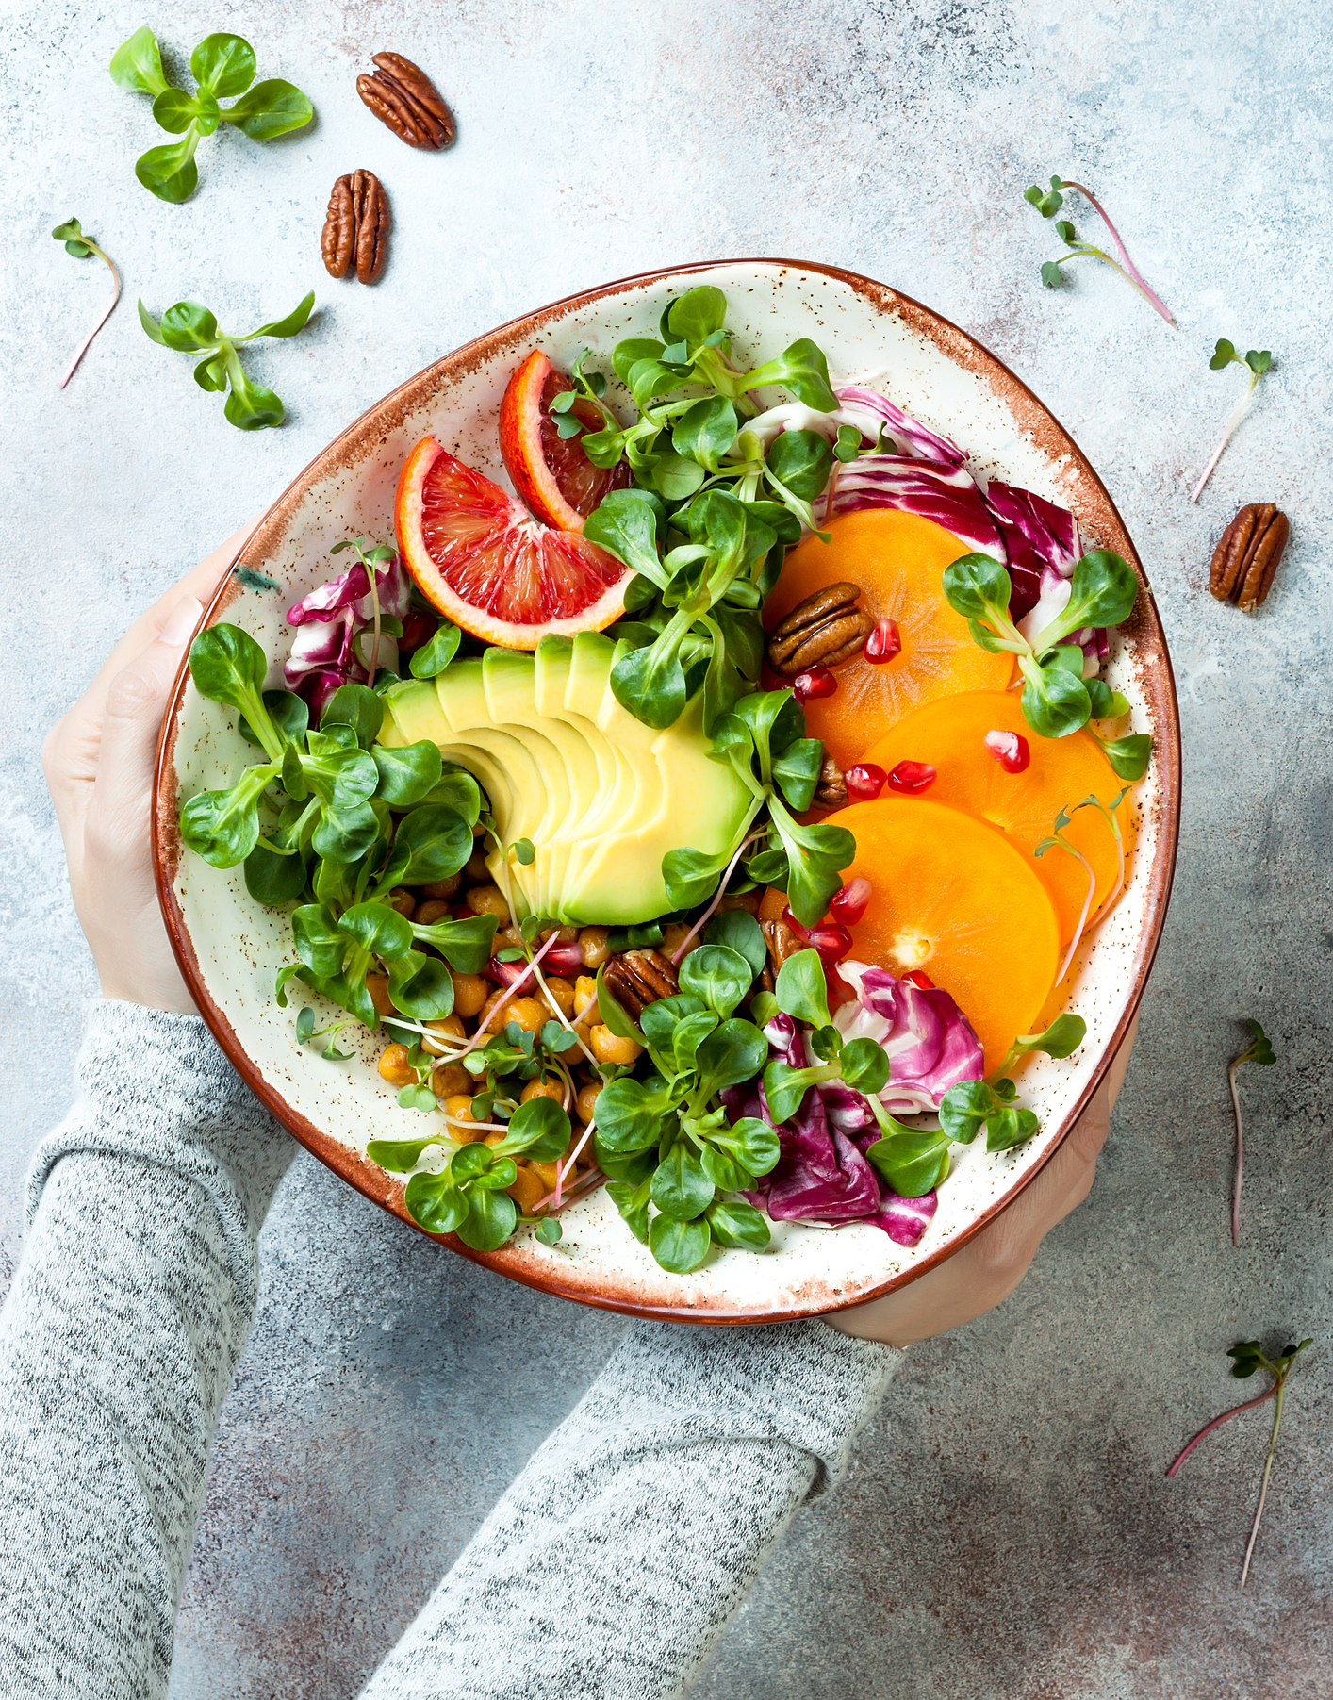
Food Connects Us to Our
Family & Friends
NationalNutritionMonth.org
eatright.org
Notes:
Food also connects us to our family and friends.
Think about all the occasions that involve food, whether it’s celebrating a holiday or another special event, such as a birthday, or simply enjoying a meal together on the weekend.
Sharing a meal is an opportunity to learn about its preparation, who made it and where the ingredients were sourced.
There may be additional benefits to sharing meals.
For example, a limited amount of research has shown that more frequent meals shared by families with adolescents helped to improve their intake of fruits and/or vegetables and sources of calcium.
(Source: Dietary Guidelines Advisory Committee. 2015. Scientific Report of the 2015 Dietary Guidelines Advisory Committee: Advisory Report to the Secretary of Health and Human Services and the Secretary of Agriculture. U.S. Department of Agriculture, Agricultural Research Service, Washington, DC. Available at: https://ods.od.nih.gov/about/2015_dgac_report.aspx.)

Slide 12


Food Connects Us through each
Stage of Life
NationalNutritionMonth.org
eatright.org
Notes:
Another way Food Connects Us is through each stage of life by providing the nutrients we need from birth and to advanced age.
For example, consuming adequate calcium from a young age helps reduce the risk of osteoporosis, or weak bones, as we age.

Slide 13

Build the Connection Across All Stages of Life
Learn how nutrient needs may change with age.
Include healthful foods from all food groups.
Focus on balanced and sustainable eating habits.
NationalNutritionMonth.org
Notes:
You can continue to build the connection across all stages of life by learning how nutrient needs may change with age.
Make sure to consult trustworthy sources, like RDNs and NDTRs. Eatright.org and MyPlate.gov are also great online resources.
Including healthful foods from all food groups and focusing on balanced and sustainable eating habits will help to form this connection during the lifecycle.
Some changes can be difficult, so it’s easier to start with just one or two changes in your eating habits at a time.
For example, if your goal is to eat more fruit. Including berries with your breakfast and an apple as a snack a few times per week may be easier than increasing your intake every day to start out.
Working with an RDN can also help you in setting realistic goals.

Slide 14
National
Nutrition Month®
NationalNutritionMonth.org
Notes:
In summary, National Nutrition Month® is an ideal time to learn more about the ways that Food Connects Us and the benefits of a healthy eating pattern.
Have fun celebrating!

Slide 15
National Nutrition Month® 2025
Questions?
Notes:
Are there any questions?

Slide 16
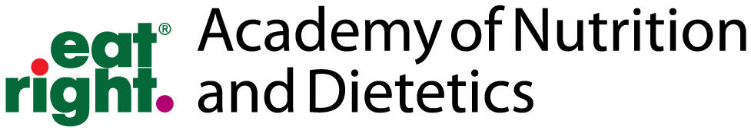
Thank You!
NationalNutritionMonth.org
eatright.org
Notes:
Thank you!

