Slide 1
National Nutrition Month® 2026
Notes:
Hello, my name is ___________________________, and I am a ________________________ (RDN, NDTR, intern, etc.).
I’m also a member of the Academy of Nutrition and Dietetics (Academy), the world’s largest organization of food and nutrition professionals.
Members of the Academy, including registered dietitian nutritionists (RDNs) and nutrition and dietetics technicians, registered (NDTRs), play a key role in shaping the public's food choices and are committed to improving the nation’s health.
As food and nutrition experts, RDNs serve in roles that have a positive impact on the health of their patients, clients and communities. RDNs offer preventive and medical nutrition therapy services in a variety of settings, and they are a trusted source about what types of food to eat.
NDTRs are also employed throughout the community in areas such as hospitals, public health clinics, nursing homes and more and use their nutrition knowledge to help people make positive lifestyle changes.

Slide 2

Discover the Power of Nutrition
Notes:
Each year during March, we celebrate National Nutrition Month®, which is a nutrition education and information campaign sponsored by the Academy. It invites everyone to learn about making informed food choices and developing sound eating and physical activity habits.
National Nutrition Month® started in 1973 as National Nutrition Week, and it became a month-long observance in 1980 in response to growing interest in nutrition.
The theme for National Nutrition Month® 2026 is Discover the Power of Nutrition, which highlights the power nutrition has in helping individuals and communities thrive.

Slide 3
Objectives
Identify at least two ways in which you can Discover the Power of Nutrition.
Explain what foods make up a healthy eating pattern.
Describe ways you can feel good with healthy habits.
Notes:
At the end of today’s presentation, you will be able to:
Identify at least two ways in which you can Discover the Power of Nutrition.
Explain what foods make up a healthy eating pattern.
Describe ways you can feel good with healthy habits.

Slide 4
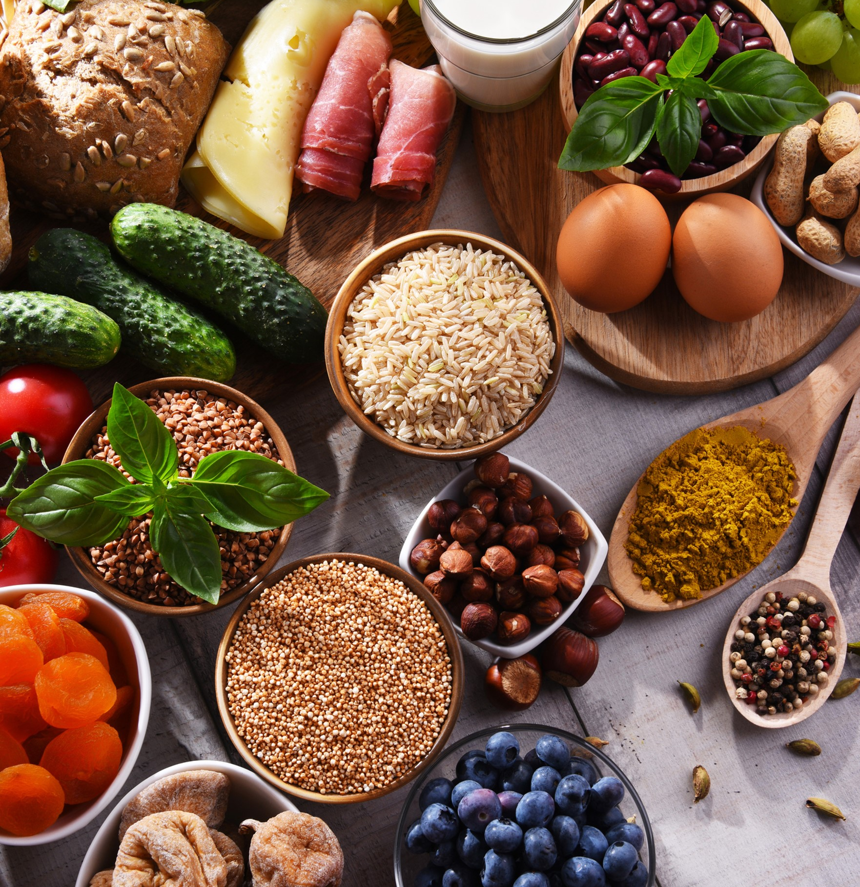
Power Your Day
Choose healthful foods from all the food groups.
Alternate your food choices for a variety of nutrients.
Avoid fad diets that promote unnecessary restrictions.
Notes:
Our food and beverage choices have the power to help us thrive. To get the most benefit from the foods and beverages you choose throughout the week, consider the following tips:
Choose healthful foods from all the food groups.
Alternate your food choices for a variety of nutrients. Including a variety of foods within each food group can help you to get the nutrients you need.
Avoid fad diets that promote unnecessary restrictions. Fad diets advertise quick and easy solutions to common concerns, like weight loss, but they don’t promote healthy or sustainable habits. These diets also may result in nutrient deficiencies.

Slide 5
Healthy Eating Patterns
Include:
  Vegetables
  Fruits
  Grains, especially whole grains
  Lean protein foods
  Low-fat or fat-free dairy or fortified soy versions
Limit:
  Added sugars
  Saturated fat
  Sodium
Notes:
There is a lot of research linking a healthy eating pattern, which consists of fruits, vegetables, whole grains, lean protein foods, and dairy or fortified soy versions, while also limiting saturated fat, sodium, and added sugars with a reduced risk of diet-related chronic diseases, such as heart disease, Type 2 diabetes, and some types of cancer.
(Source: U.S. Department of Agriculture and U.S. Department of Health and Human Services. Dietary Guidelines for Americans, 2020-2025. 9th Edition. December 2020. Available at DietaryGuidelines.gov.)
If you’re not sure what a healthy eating pattern looks like for you, there are resources available.
RDNs and NDTRs play a critical role in helping people understand the connection between the foods individuals and communities eat, and how these foods impact health throughout life.

Slide 6
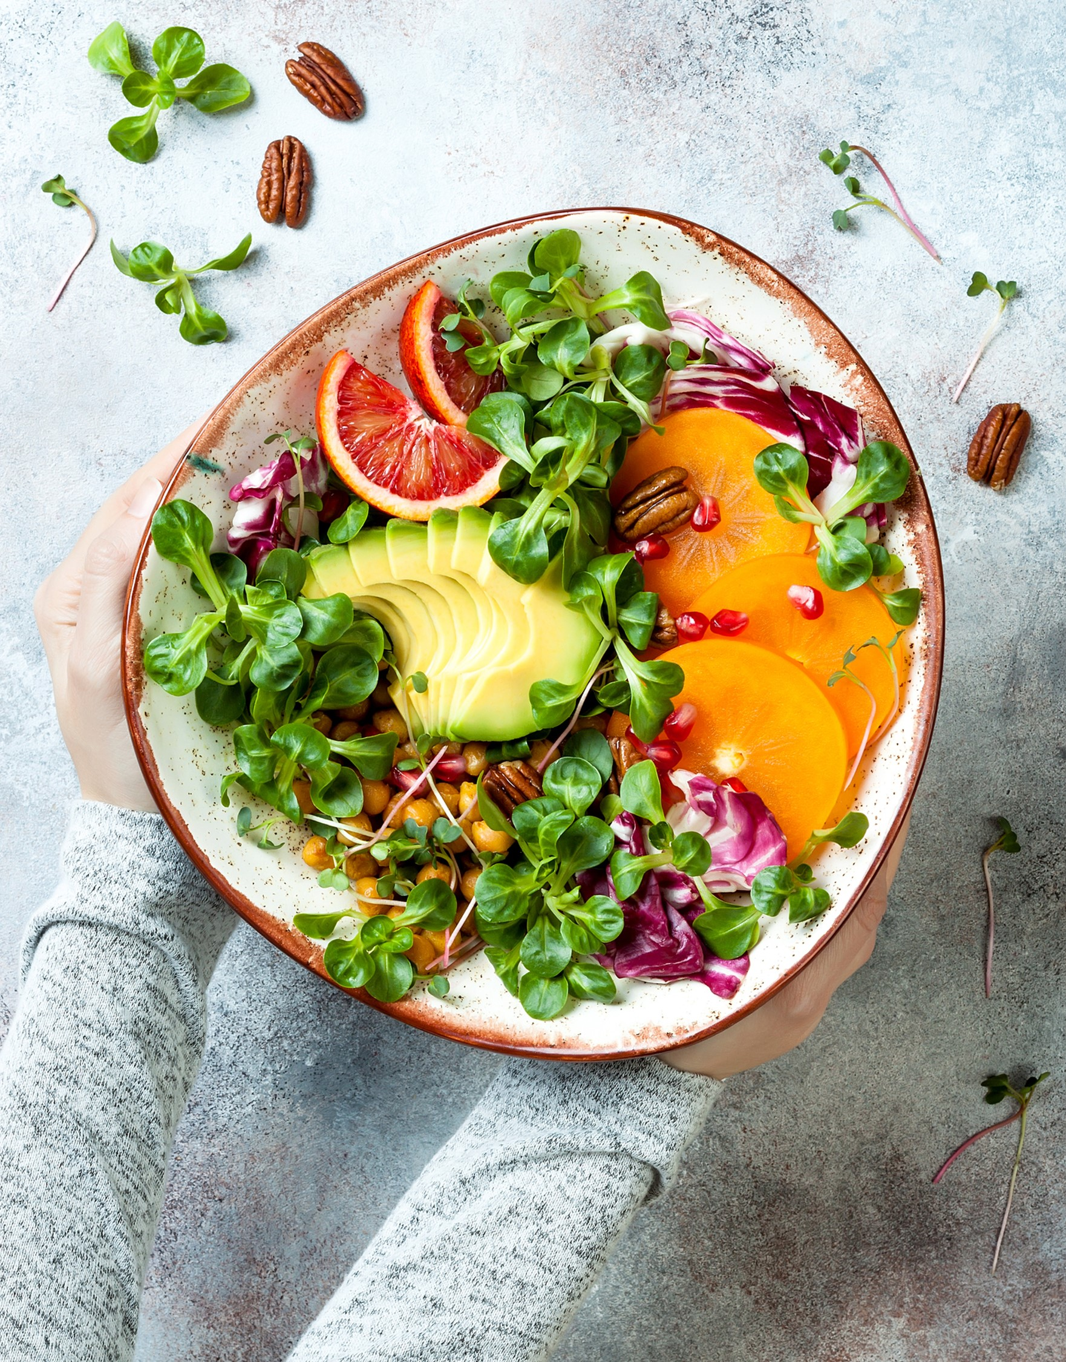
Choose Variety
Notes:
As mentioned earlier, alternating your food choices to include a variety of nutrients is also important.
Try choosing different foods throughout the day and week.
For example, when it comes to vegetables, include:
Dark green vegetables, like broccoli, bok choy, kale and spinach
Red and orange vegetables, like tomato, sweet potato, red or orange bell pepper and carrot
Beans, peas and lentils – which provide plant-based protein with dietary fiber
And don’t be afraid to include starchy vegetables like green peas or corn, or other vegetables like beets and avocado. They all offer important nutrients when included in a healthy eating pattern.

Slide 7

Stay Nourished on Limited Budgets
Plan grocery lists around sales.
Learn cooking and meal preparation skills that work with the resources you have.
Locate community resources.
Notes:
Resources can be a big obstacle when it comes to healthy eating. But there are things you can do to stay nourished on a limited budget.
Making a grocery list and sticking to it can be helpful when you’re trying to buy only what you need. Another helpful tip is to check store sales when you’re planning your meals.
Many recipes also can be modified to use less expensive ingredients or items – for example, replacing some or all the meat in a soup or casserole with beans, or using frozen or canned vegetables in place of fresh ones.
Learning cooking skills that work with the tools you have can also be helpful. Many foods can be made without special equipment. And knowing how to prepare a variety of foods can help you make use of budget-friendly ingredients.
If you’re eligible, it also may be necessary to locate community resources, such as SNAP, WIC and local food pantries.
Are there any tips you have for eating on a limited budget?

Slide 8

Find Advice Backed by Science
Find accurate sources for nutrition information.
Meet with an RDN who specializes in your unique needs.
Receive personalized nutrition information from an RDN to meet your health goals.
Notes:
Whether you’re looking at nutrition headlines or searching for nutritious options to eat, boost your confidence in your choices with accurate sources of nutrition information.
Boost your confidence in your food and beverage choices with an RDN. A Nutrition Expert allows you to receive personalized nutrition information to meet your health goals.
RDNs provide preventive and medical nutrition therapy services, also called MNT, and specialize in different areas, such as diabetes.
MNT is a personalized, nutrition-based treatment plan that involves “assessing a person’s health status, medical history and eating patterns; identifying any dietary issues; and creating a personalized, culturally appropriate and medically supervised nutrition plan to treat or manage one or more health conditions”. (Source: https://www.eatrightpro.org/advocacy/initiatives/medical-nutrition-therapy-act/mnt-infographic)
RDNs are skilled at helping people adopt a healthy eating pattern that is mindful of their personal food and cultural preferences. (You may have to ask your doctor for a referral to an RDN.)

Slide 9

Find a Nutrition Expert at
eatright.org
Notes:
To find a Nutrition Expert who specializes in your unique needs in your area, visit the Academy of Nutrition and Dietetics’ website at www.eatright.org.

Slide 10


Feel Good with Healthy Habits
Notes:
When we talk about nutrition, the foods and drinks we consume get a lot of attention. But there are a variety of things we can do to create healthy habits.

Slide 11

Physical Activity
Notes:
For example, include physical activity in ways that work for you.
Whether you enjoy group activities or those that you can do alone – there are so many ways to be physically active, from walking and bicycling, to fitness classes and sports.
Physical activity can help improve our mood and manage stress. It also has been shown to reduce the risk of chronic diseases such as heart disease and high blood pressure.
Children and adolescents are encouraged to be physically active for at least one hour every day.
For adults, the recommendation is to get 150 minutes or more of moderate-intensity physical activity each week. But any type and amount of activity is better than none.
More information on the types of physical activity that are recommended can be found in the 2018 Physical Activity Guidelines for Americans. https://odphp.health.gov/our-work/nutrition-physical-activity/physical-activity-guidelines/current-guidelines

Slide 12

Food Safety
Notes:
Safe food practices are also important when we think about health.
Certain groups of people are at a higher risk of serious side effects from foodborne illness. This includes individuals with a compromised immune system, children, older adults and individuals who are pregnant. These groups should avoid high-risk foods such as raw or unpasteurized dairy products, raw or undercooked eggs, raw sprouts and undercooked or raw meat, poultry and seafood.

Slide 13
Four Steps to Food Safety
Clean
Cook
  Hands
  Dishes and utensils
  Countertops and sinks
Fish and whole cuts of meat: 145°F*
Ground meat: 160°F
Eggs: 160°F
Poultry, mixed dishes and leftovers: 165°F
*Let meat rest for 3 minutes before carving or eating
Separate
R
Chill
Raw and ready-to-eat foods and tools used to prepare them, including:
  Cutting boards
  Knives, spatulas and tongs
  Dishes and serving platters
Perishable foods, including:
  Milk, yogurt, cheese and eggs
  Meat, poultry and fish
  Cut or prepared fruits and vegetables
  Prepared food and leftovers
Notes:
You can reduce your risk of foodborne illness by following four steps at home: clean, separate, cook and chill.
Cleaning includes handwashing. Handwashing is an easy and effective way to prevent the spread of germs, including those that cause foodborne illness. Use soap and clean water to wash hands for a minimum of 20 seconds. It’s also important to keep kitchen surfaces clean, like countertops, cutting boards, utensils, sinks and appliances.
Separating raw and ready-to-eat foods is important to help prevent cross-contamination. Cross-contamination occurs when harmful bacteria are spread from one surface to another. You should use separate cutting boards and utensils when preparing raw foods.
When cooking food, food thermometers are the only way to ensure food is cooked to a safe minimum internal temperature. The recommended temperature varies depending on the food. A few examples of foods and their minimum internal temperature are listed on this slide.
It’s also important not to let perishable foods sit at room temperature for too long. Bacteria grow quickly between 40°F and 140°F. Perishable foods, like the ones listed on the slide, should be refrigerated right away and not kept out more than 2 hours and only 1 hour if the temperature is 90 degrees or more.
For additional food safety resources, visit https://www.eatright.org/food/home-food-safety

Slide 14

Healthy Habits
Notes:
There are a variety of healthy habits we can adopt to help us feel good. Physical activity and food safety are just two examples. Other healthy habits might include:
Planning meals and snacks in advance to meet your nutrition goals and manage mealtime stress
Limiting screen time
And limiting caffeine or alcohol intake
What do healthy habits look like to you?

Slide 15

Questions?
Notes:
Are there any questions?

Slide 16

#NationalNutritionMonth
Notes:
National Nutrition Month® is an ideal time to Discover the Power of Nutrition.
Have fun celebrating!

Slide 17
Thank You!
Notes:
Thank you!

