Slide 1

MARZO 2023
National Nutrition Month®
NationalNutritionMonth.org
eatright.org
Notes:
Hello, my name is ___________________________, and I am a ________________________ (RDN, NDTR, intern, etc.).
I’m also a member of the Academy of Nutrition and Dietetics (Academy), the world’s largest organization of food and nutrition professionals.
Members of the Academy play a key role in shaping the public's food choices and are committed to improving the nation’s health.
As food and nutrition experts, registered dietitian nutritionists (RDNs) serve in roles that have a positive impact on the health of their patients, clients and communities. RDNs offer preventive and medical nutrition therapy services in a variety of settings, and they are a trusted source about what types of food to eat.
If you would like to improve your current eating habits and would benefit from personalized nutrition guidance, a registered dietitian nutritionist can help you develop a healthful eating plan that is as unique as you are.

Slide 2
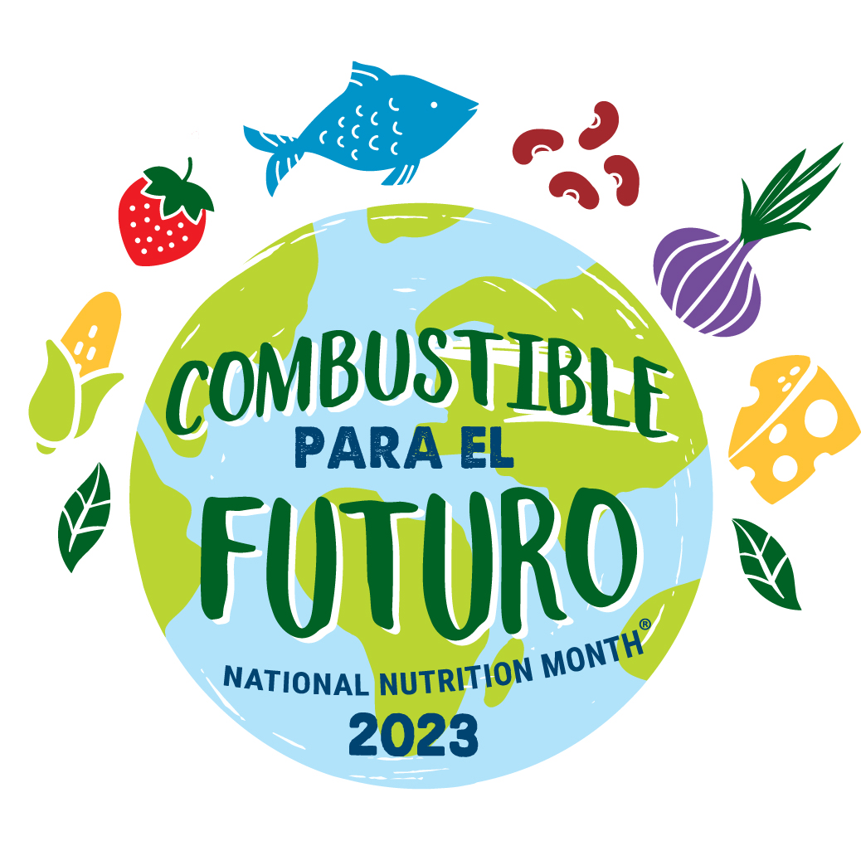
MARZO 2023
NationalNutritionMonth.org
eatright.org
Notes:
Each year during March, we celebrate National Nutrition Month®, which is a nutrition education and information campaign sponsored by the Academy. It invites everyone to learn about making informed food choices and developing sound eating and physical activity habits.
National Nutrition Month® started in 1973 as National Nutrition Week, and it became a month-long observance in 1980 in response to growing interest in nutrition.
2023 will be its 50th anniversary, and the theme for this year’s National Nutrition Month® is Fuel for the Future.

Slide 3
Objetivos:
Enumerar los nutrientes de los alimentos
Describir qué hace que un alimento sea rico en nutrientes
Explicar dos formas de cargar Combustible para el futuro con un presupuesto limitado
Notes:
At the end of today’s presentation, you will be able to:
List the six types of nutrients found in foods.
Describe what makes a food nutrient-dense.
Explain two ways to “Fuel for the Future” on a limited budget.

Slide 4
Nutrientes:
Carbohidratos
Proteínas
Grasas
Vitaminas
Minerales
Agua
Notes:
There are six types of nutrients.
Does anyone know what they are?
Carbohydrates, proteins, fats, vitamins, minerals, and water.
Certain foods are known for being a good source of a particular nutrient but often the foods we eat include a mix of nutrients.
For example, fruits, like oranges, are a great source of vitamin C, but they are also a type of carbohydrate and provide water, along with other vitamins, including folate.
Choosing a variety of foods from each food group and within each food group is important, since no single food or food group provides all the nutrients we need for good health.

Slide 5

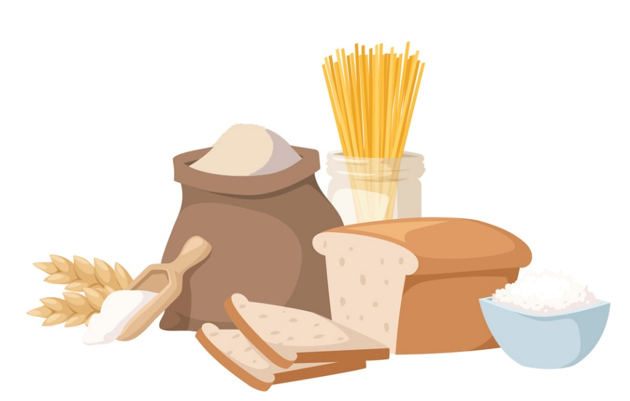
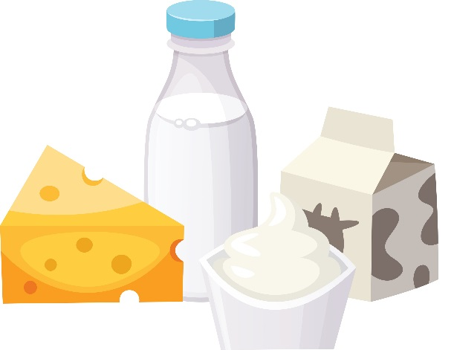
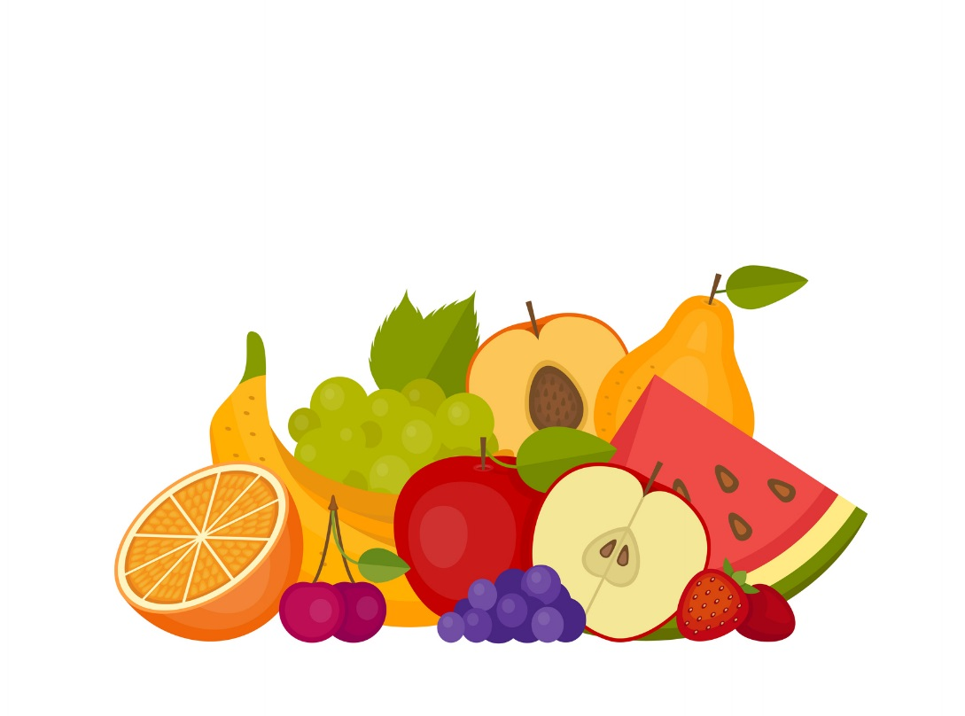
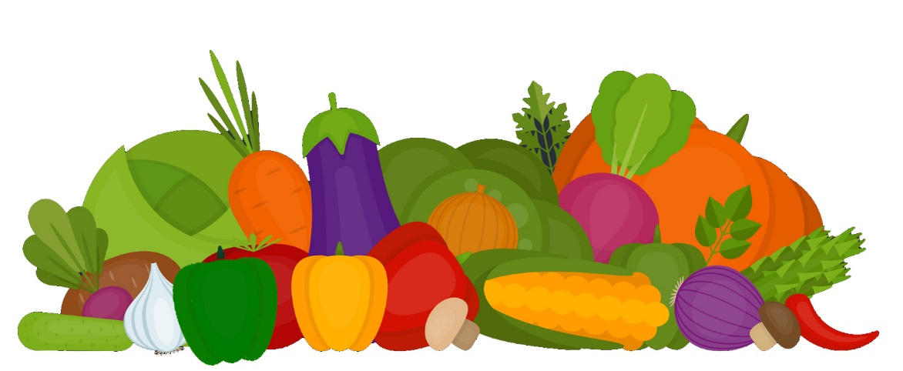
Grupos de Alimentos
Notes:
Who can tell me what the five food groups are?
The five food groups, as depicted on this slide, are: Dairy, Grains, Protein Foods, Vegetables, and Fruits.
Although we tend to choose foods and beverages based on factors, such as their taste, cost, and convenience, there are advantages to focusing on nutrient-dense forms.

Slide 6
“Los alimentos y bebidas ricos en nutrientes brindan vitaminas, minerales y otros componentes que promueven la salud y tienen pocos azúcares, grasas saturadas y sodio añadidos. Las verduras, frutas, cereales integrales, pescados y mariscos, huevos, frijoles, guisantes y lentejas, frutos secos y semillas sin sal, productos lácteos sin grasa o bajos en grasa, carnes de res y aves magras –(cuando se preparan con poco o sin nada de azúcar, grasas saturadas y sodio añadidos) son alimentos ricos en nutrientes”.
Fuente: U.S. Department of Agriculture and U.S. Department of Health and Human Services. Dietary Guidelines for Americans, 2020-2025. 9th Edition. December 2020. Available at DietaryGuidelines.gov.
Notes:
According to the 2020-2025 Dietary Guidelines for Americans, “Nutrient-dense foods and beverages provide vitamins, minerals, and other health-promoting components and have little added sugars, saturated fat, and sodium. Vegetables, fruits, whole grains, seafood, eggs, beans, peas, and lentils, unsalted nuts and seeds, fat-free and low-fat dairy products, and lean meats and poultry—when prepared with no or little added sugars, saturated fat, and sodium— are nutrient-dense foods”
A healthy eating routine, includes a variety of nutrient-dense foods and in the recommended amounts from each food group.
No matter your age or activity level, making healthful food and drink choices will provide your body with energy now and Fuel for the Future.

Slide 7
Combustible para el futuro
Coma pensando en el medio ambiente.
Consulte a un dietista nutricionista registrado (DNR).
Manténgase bien nutrido y ahorre dinero.
Coma una variedad de comidas de todos los grupos de alimentos.
Prepare alimentos sabrosos en casa.
Notes:
These are a few says that we can Fuel for the Future:
Eat with the environment in mind.
See a Registered Dietitian Nutritionist (RDN).
Stay nourished and save money.
Eat a variety of foods from all food groups.
Make tasty foods at home.

Slide 8
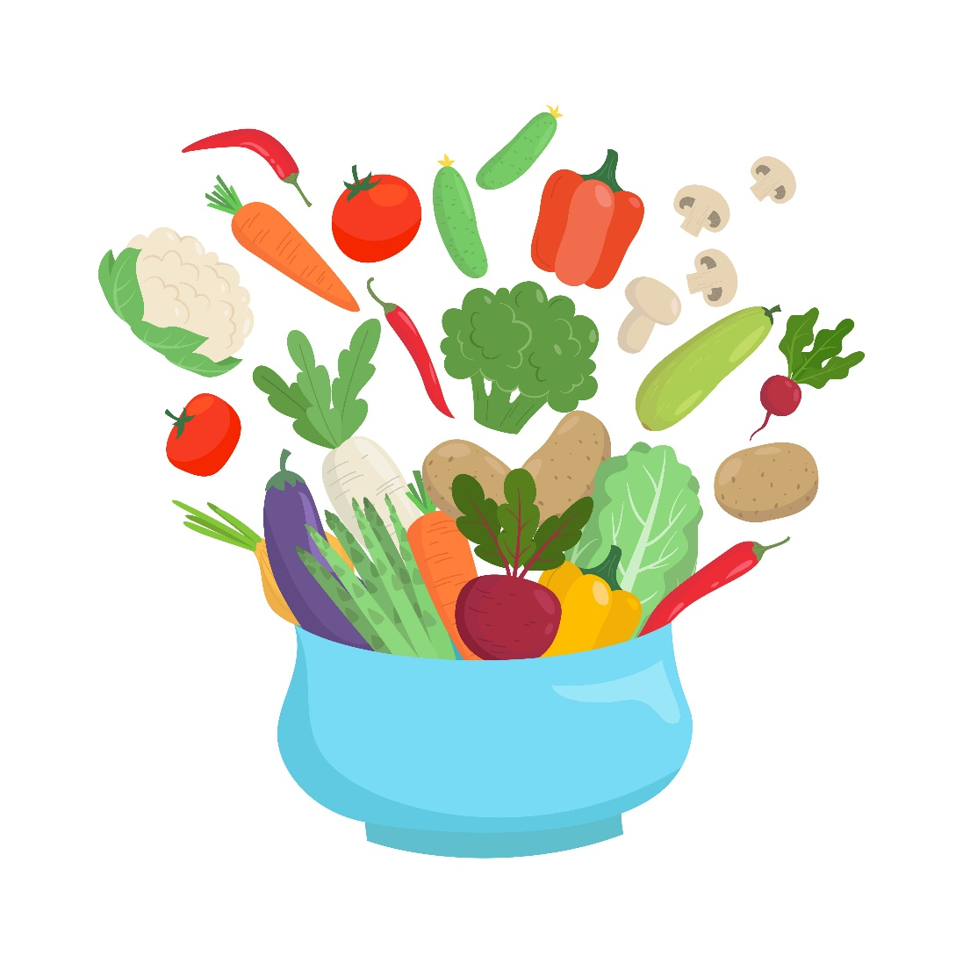
Coma pensando en el medio ambiente.
Disfrute de más alimentos y bocaditos basados en plantas.
Compre los alimentos menos embalados.
Compre alimentos de temporada y compre productos de su localidad cuando le sea posible.
Prepare un jardín en una maceta o en el patio, y cultive sus alimentos en casa.
Notes:
Ways to eat with the environment in mind include:
Enjoying more foods that come from plants, like fruits, vegetables, grains, nuts and seeds.
Purchasing foods with minimal packaging, such as buying items in bulk.
Buying foods that are in season and shopping locally when possible. One example would be buying produce from a farmers market.
You can also consider growing food at home by starting a garden in a container or backyard.

Slide 9
Consulte a un dietista nutricionista registrado (DNR).
Pida a su médico que lo refiera a un DNR.
Encuentre un DNR que se especialice en sus necesidades personales.
Aprenda como sus necesidades nutricionales pueden cambiar con la edad.
Reciba información nutricional personalizada para alcanzar sus objetivos de salud.
Notes:
Another way to Fuel for the Future is to see a registered dietitian nutritionist, also known as an RDN.
RDNs are the nutrition experts and can provide sound, easy-to-follow personalized nutrition advice.
Ask your doctor for a referral to an RDN, then find an RDN who specializes in your unique needs.
By seeing an RDN, you can learn how nutrient needs may change with age and receive personalized nutrition information to meet your health goals.

Slide 10
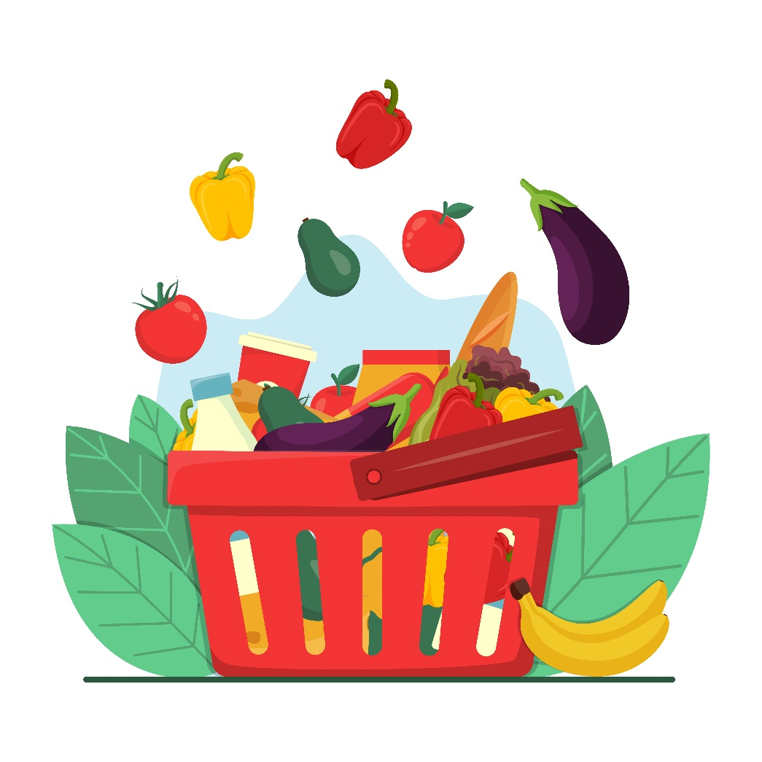
Manténgase bien nutrido y ahorre dinero.
Planifique sus comidas y refrigerios.
Mire qué comida tiene en casa antes de comprar más.
Use una lista de compras y aproveche las promociones cuando compre los alimentos.
Aprenda sobre los recursos comunitarios como SNAP, WIC y los bancos de alimentos locales.
Notes:
RDNs can also help you to stay nourished and save money while fueling for the future.
Planning your meals and snacks is a great place to start. It’s not only a habit that will help you eat healthfully, but it can also save you money and reduce wasted food.
Start by seeing what foods you have at home, then use a grocery list to shop sales when purchasing the foods you need.
You can also learn about resources in your community, such as SNAP, WIC, and local food banks.
These types of programs offer food assistance to individuals who are eligible.

Slide 11
Programas de Nutrición
Programa de Asistencia Nutricional Suplementaria (SNAP)
SNAP proporciona un fondo electrónico para ayudar a los hogares a obtener alimentos que son esenciales para sostener una dieta saludable. Esto incluye frutas, verduras, alimentos con proteínas, productos lácteos, panes y cereales, y más. La elegibilidad se determina según los ingresos del hogar y los recursos que le hagan falta. Comuníquese con la oficina de SNAP de su estado para obtener instrucciones sobre cómo presentar una solicitud.
Programa Especial de Nutrición Suplementaria para Mujeres, Bebés y Niños (WIC)
WIC está diseñado para atender a mujeres embarazadas, posparto y lactantes en riesgo nutricional, además de bebés y niños hasta la edad de cinco años que estén en riesgo nutricional. También se deben cumplir requisitos de ingresos del hogar. Los participantes del programa son elegibles para recibir alimentos suplementarios y educación nutricional. WIC también se puede combinar con otros programas gubernamentales como SNAP, NSB y NSLP. Comuníquese con la agencia WIC de su estado para encontrar la ubicación más cercana para presentar su solicitud.
Fuente: https://www.fns.usda.gov/programs
Notes:
For example, the Supplemental Nutrition Assistance Program, also known as SNAP, provides assistance to individuals who qualify so that nutritious foods, including fruits, vegetables, protein foods, dairy products, breads and cereals can be purchased.
WIC is another type of program that offers supplemental foods and nutrition education to eligible individuals who are pregnant and breastfeeding and their children up until the age of five.
Please keep in mind that these are only two examples of federal nutrition programs that are offered through the Food and Nutrition Service of the U.S. Department of Agriculture and a brief description of each.
More information is available on the USDA’s website: https://www.fns.usda.gov/programs.

Slide 12
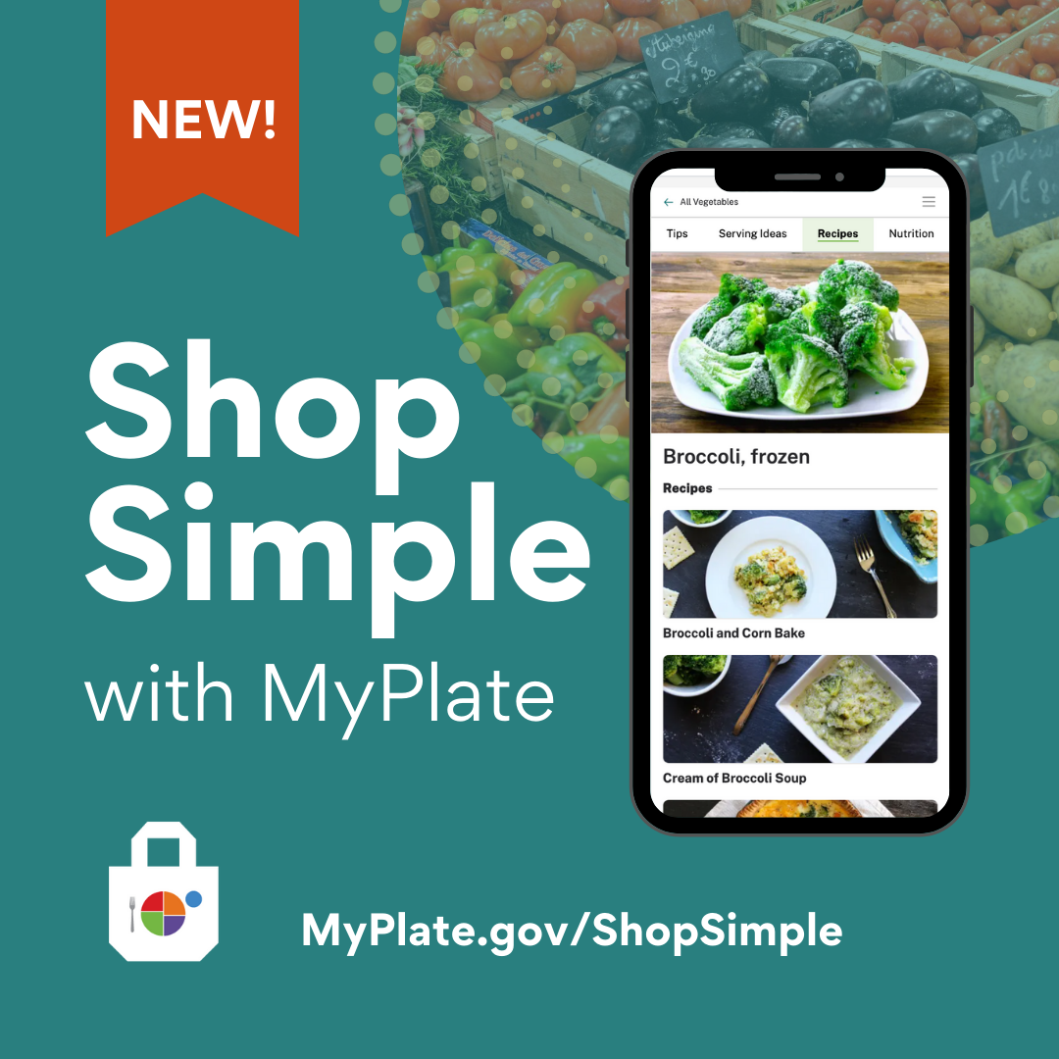
Notes:
Another resource that is available through the USDA is “Shop Simple with MyPlate”.
According to MyPlate.gov, “Shop Simple with MyPlate is a tool to help Americans save money while shopping for healthy food choices. Consumers can use this tool to quickly find savings in their local area and discover new ways to prepare budget-friendly foods”.
Source: https://www.myplate.gov/resources/graphics/promotional-images

Slide 13
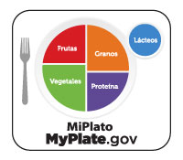
Notes:
Earlier we discussed the five food groups.
MyPlate, as shown on this slide, is considered the “official symbol of the five food groups”, and it serves as a reminder to include the right mix of foods with your meals.
MyPlate encourages us to balance our meals so that half of the plate includes fruits and vegetables, and the other half features a protein food and grain. A serving of dairy completes the meal.
This approach to eating is important at every stage of life and can have a positive effect on our health over time.
It’s also important to note that some meals will contain a mixture of foods from several food groups, so they may not be portioned out in this way. Or, the meal may be eaten out of a bowl.
For example, a casserole may include chicken with brown rice, broccoli, cauliflower, carrots and low-fat cheese. In this case, four of the five food groups are represented. Choosing a piece of fruit as a dessert would be a great way to make sure this food group is included, too.

Slide 14
Coma una variedad de comidas de todos los grupos de alimentos.
Incorpore sus comidas y tradiciones culturales favoritas.
Coma alimentos en varias formas, incluyendo frescos, congelados, enlatados y secos.
Evite las dietas de moda que promueven restricciones innecesarias.
Ponga en práctica el ser agradecido con su cuerpo dándole el combustible que necesita
Notes:
Eating a variety of foods from all food groups will ensure you get the nutrients your body needs.
Including your favorite cultural foods and traditions can be an important part of a healthy eating routine. It allows you to adapt healthful eating recommendations to include foods which reflect your personal preferences and culture.
You can also eat foods in various forms, which can help keep food costs down. For example, when fresh produce is not in season, buying canned or frozen fruits and vegetables is a convenient way to include these foods. Remember to look for nutrient-dense forms, meaning those that have little added sugars, saturated fat, and sodium.
A healthy eating routine offers a variety of foods, so avoid fad diets that promote unnecessary restrictions.
Another important factor is to practice gratitude for your body by giving it the fuel it needs.

Slide 15

Prepare alimentos sabrosos en casa.
Aprenda a cocinar y preparar comidas.
Pruebe nuevos sabores y alimentos de todo el mundo.
Encuentre formas creativas de utilizar las sobras de comida en lugar de tirarlas.
Cree recuerdos felices comiendo con los amigos y la familia cuando le sea posible.
Notes:
How foods are prepared can also influence our eating habits and health. Make tasty foods at home by learning cooking and meal preparation skills. This will allow you to control the ingredients, as well as the amounts, that are used when preparing recipes.
For example, you can use healthier ingredients to flavor foods and beverages, such as fresh or dried herbs and spices instead of salt. And fruits offer a natural sweetness.
Try new flavors and foods from around the world as you plan your meals for the week.
Instead of eating the same foods every day or tossing them, find creative ways to use leftovers.
For instance, leftover grilled chicken could be shredded and eaten on salad, enjoyed in a wrap with veggies for lunch, or used to make soup.
Spending time in the kitchen and around the table will allow you to create happy memories. Try to make a point of eating with friends and family, when possible. This can even be done virtually.

Slide 16
Encuentre un Experto en Nutrición en eatright.org
Notes:
Remember that a healthy eating routine is one that meets your unique needs.
There are many ways to eat healthfully while you Fuel for the Future.
For additional food and nutrition information and to find a nutrition expert in your area, visit eatright.org.

Slide 17
¿Preguntas?
Notes:
Are there any questions?

Slide 18
¡Gracias!

