Slide 1

MARCH 2023
National Nutrition Month®
NationalNutritionMonth.org
eatright.org
Notes:
Hello, my name is ___________________________, and I am a ________________________ (RDN, NDTR, intern, etc.).
I’m also a member of the Academy of Nutrition and Dietetics (Academy), the world’s largest organization of food and nutrition professionals.
Members of the Academy play a key role in shaping the public's food choices and are committed to improving the nation’s health.
As food and nutrition experts, registered dietitian nutritionists (RDNs) serve in roles that have a positive impact on the health of their patients, clients and communities. RDNs offer preventive and medical nutrition therapy services in a variety of settings, and they are a trusted source about what types of food to eat.
If you would like to improve your current eating habits and would benefit from personalized nutrition guidance, a registered dietitian nutritionist can help you develop a healthful eating plan that is as unique as you are.

Slide 2
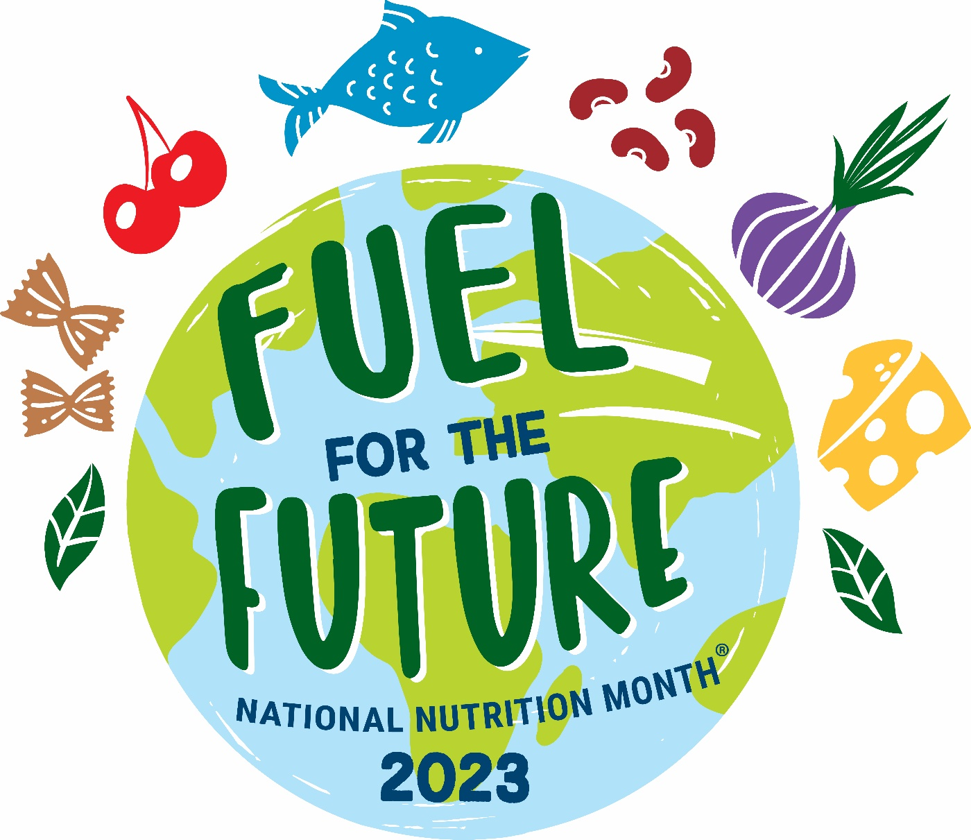
MARCH 2023
NationalNutritionMonth.org
eatright.org
Notes:
Each year during March, we celebrate National Nutrition Month®, which is a nutrition education and information campaign sponsored by the Academy. It invites everyone to learn about making informed food choices and developing sound eating and physical activity habits.
National Nutrition Month® started in 1973 as National Nutrition Week, and it became a month-long observance in 1980 in response to growing interest in nutrition.
2023 will be its 50th anniversary, and the theme for this year’s National Nutrition Month® is Fuel for the Future.

Slide 3
Objectives
List the nutrients found in foods.
Describe what makes a food nutrient-dense.
Explain two ways to Fuel for the Future on a limited budget.
Notes:
At the end of today’s presentation, you will be able to:
List the six types of nutrients found in foods.
Describe what makes a food nutrient-dense.
Explain two ways to “Fuel for the Future” on a limited budget.

Slide 4
Nutrients
Carbohydrates
Proteins
Fats
Vitamins
Minerals
Water
Notes:
There are six types of nutrients.
Does anyone know what they are?
Carbohydrates, proteins, fats, vitamins, minerals, and water.
Certain foods are known for being a good source of a particular nutrient but often the foods we eat include a mix of nutrients.
For example, fruits, like oranges, are a great source of vitamin C, but they are also a type of carbohydrate and provide water, along with other vitamins, including folate.
Choosing a variety of foods from each food group and within each food group is important, since no single food or food group provides all the nutrients we need for good health.

Slide 5

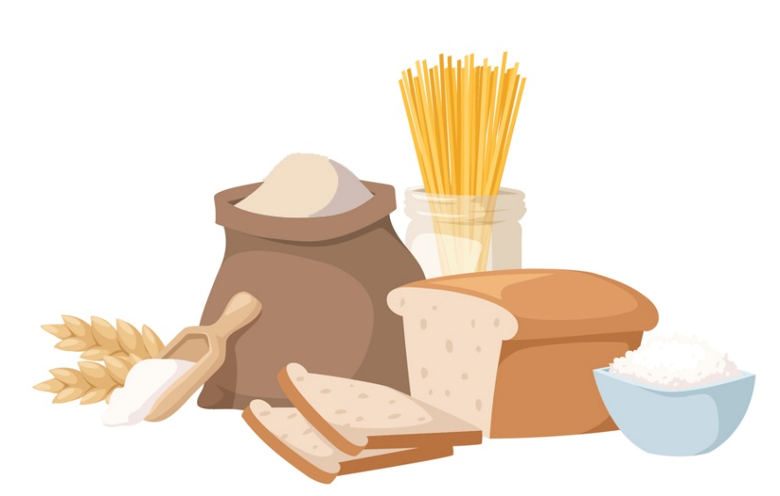
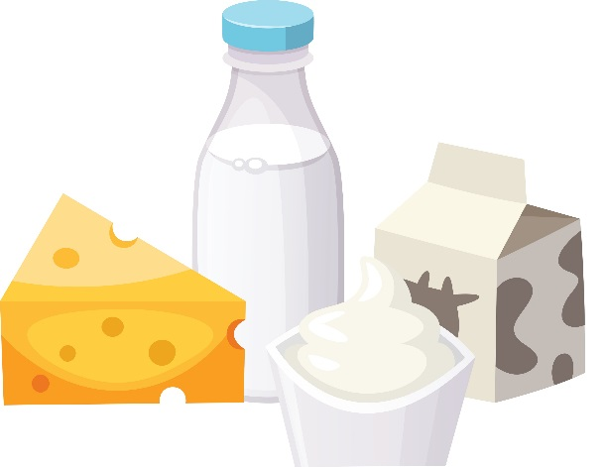
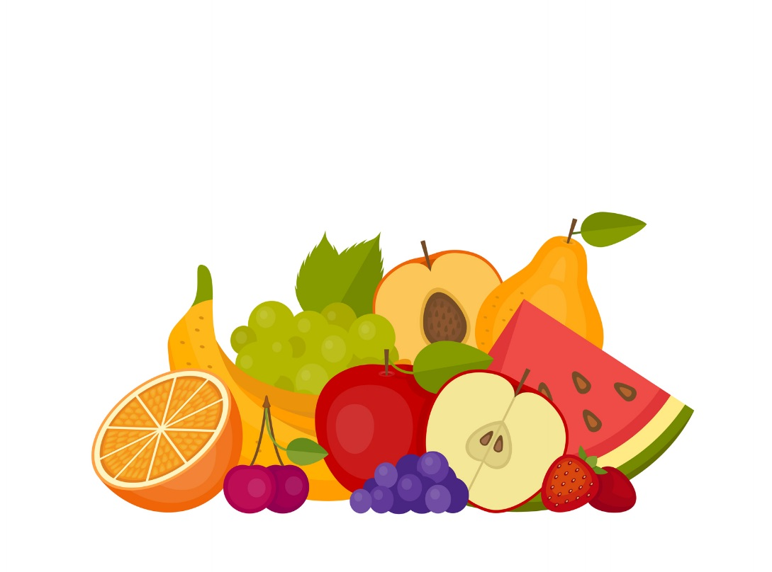
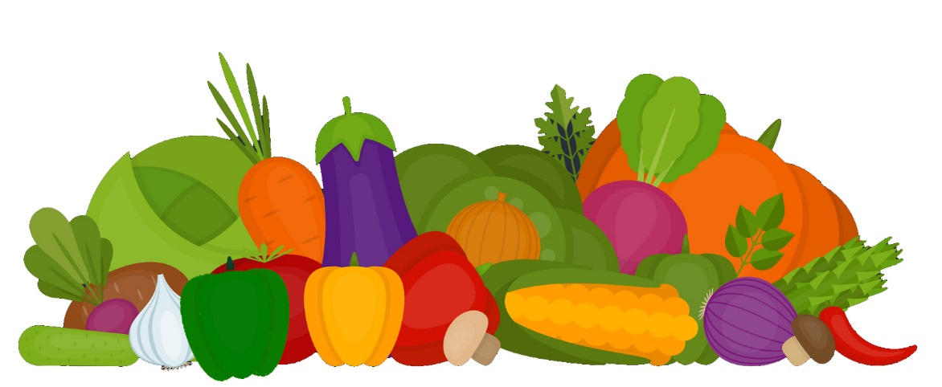
Food Groups
Notes:
Who can tell me what the five food groups are?
The five food groups, as depicted on this slide, are: Dairy, Grains, Protein Foods, Vegetables, and Fruits.
Although we tend to choose foods and beverages based on factors, such as their taste, cost, and convenience, there are advantages to focusing on nutrient-dense forms.

Slide 6
“Nutrient-dense foods and beverages provide vitamins, minerals, and other health-promoting components and have little added sugars, saturated fat, and sodium. Vegetables, fruits, whole grains, seafood, eggs, beans, peas, and lentils, unsalted nuts and seeds, fat-free and low-fat dairy products, and lean meats and poultry—when prepared with no or little added sugars, saturated fat, and sodium— are nutrient-dense foods.”
Source: U.S. Department of Agriculture and U.S. Department of Health and Human Services. Dietary Guidelines for Americans, 2020-2025. 9th Edition. December 2020. Available at DietaryGuidelines.gov.
Notes:
According to the 2020-2025 Dietary Guidelines for Americans, “Nutrient-dense foods and beverages provide vitamins, minerals, and other health-promoting components and have little added sugars, saturated fat, and sodium. Vegetables, fruits, whole grains, seafood, eggs, beans, peas, and lentils, unsalted nuts and seeds, fat-free and low-fat dairy products, and lean meats and poultry—when prepared with no or little added sugars, saturated fat, and sodium— are nutrient-dense foods”
A healthy eating routine, includes a variety of nutrient-dense foods and in the recommended amounts from each food group.
No matter your age or activity level, making healthful food and drink choices will provide your body with energy now and Fuel for the Future.

Slide 7
Fuel for the Future
Eat with the environment in mind.
See a Registered Dietitian Nutritionist (RDN).
Stay nourished and save money.
Eat a variety of foods from all food groups.
Make tasty foods at home.
Notes:
These are a few says that we can Fuel for the Future:
Eat with the environment in mind.
See a Registered Dietitian Nutritionist (RDN).
Stay nourished and save money.
Eat a variety of foods from all food groups.
Make tasty foods at home.

Slide 8
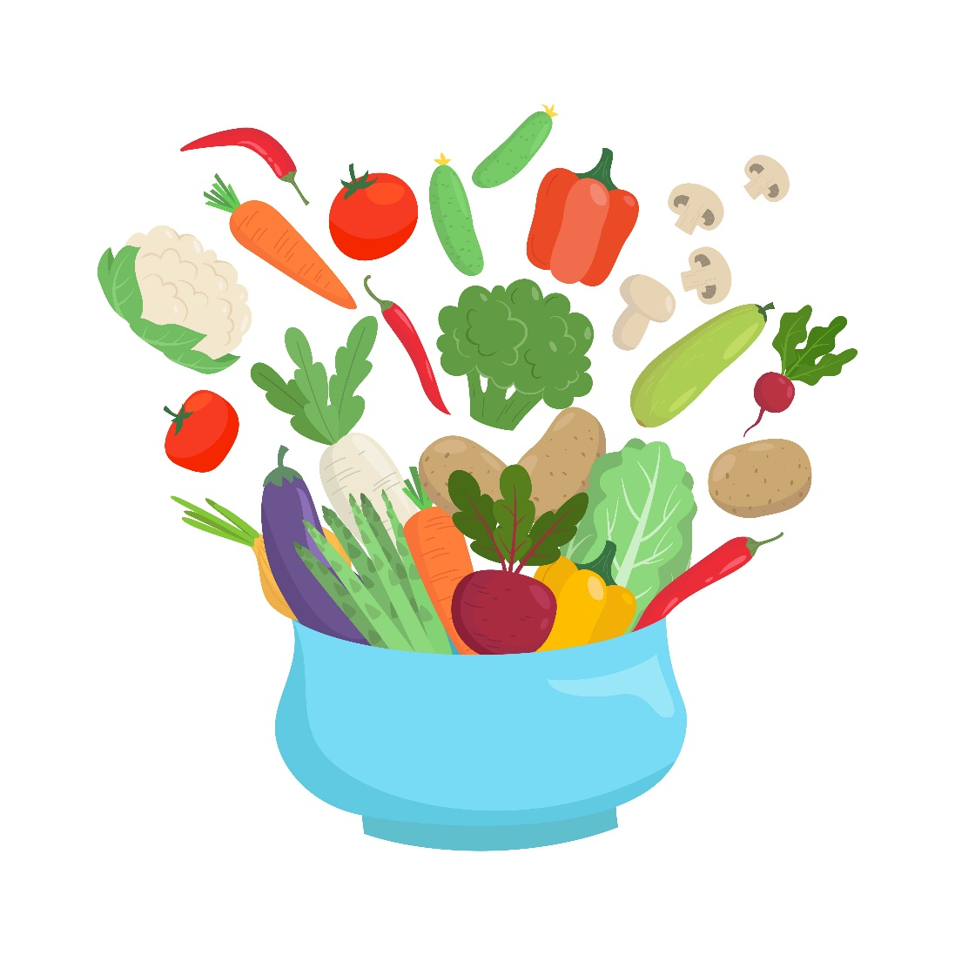
Eat with the environment in mind.
Enjoy more plant-based meals and snacks.
Purchase foods with minimal packaging.
Buy foods in season and shop locally when possible.
Start a container or backyard garden to grow food at home.
Notes:
Ways to eat with the environment in mind include:
Enjoying more foods that come from plants, like fruits, vegetables, grains, nuts and seeds.
Purchasing foods with minimal packaging, such as buying items in bulk.
Buying foods that are in season and shopping locally when possible. One example would be buying produce from a farmers market.
You can also consider growing food at home by starting a garden in a container or backyard.

Slide 9
See a Registered Dietitian Nutritionist (RDN).
Ask your doctor for a referral to an RDN.
Find an RDN who specializes in your unique needs.
Learn how nutrient needs may change with age.
Receive personalized nutrition information to meet your health goals.
Notes:
Another way to Fuel for the Future is to see a registered dietitian nutritionist, also known as an RDN.
RDNs are the nutrition experts and can provide sound, easy-to-follow personalized nutrition advice.
Ask your doctor for a referral to an RDN, then find an RDN who specializes in your unique needs.
By seeing an RDN, you can learn how nutrient needs may change with age and receive personalized nutrition information to meet your health goals.

Slide 10
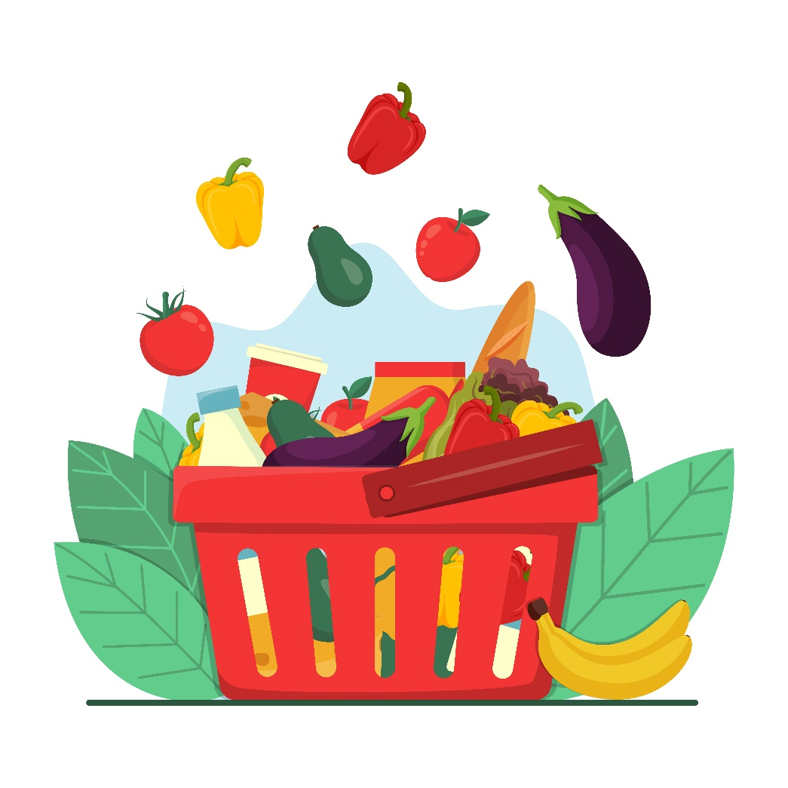
Stay nourished and save money.
Plan your meals and snacks.
See what foods you have at home before purchasing more.
Use a grocery list and shop sales when purchasing food.
Learn about community resources such as SNAP, WIC and local food banks.
Notes:
RDNs can also help you to stay nourished and save money while fueling for the future.
Planning your meals and snacks is a great place to start. It’s not only a habit that will help you eat healthfully, but it can also save you money and reduce wasted food.
Start by seeing what foods you have at home, then use a grocery list to shop sales when purchasing the foods you need.
You can also learn about resources in your community, such as SNAP, WIC, and local food banks.
These types of programs offer food assistance to individuals who are eligible.

Slide 11
Nutrition Programs
Supplemental Nutrition Assistance Program (SNAP)
SNAP provides an electronic fund to help households get foods that are essential for sustaining a healthy diet. This includes fruits, vegetables, protein foods, dairy products, breads and cereals, and more. Eligibility is determined based on household income and limited resources. Contact your state’s SNAP office for directions on how to apply.
Special Supplemental Nutrition Program for Women, Infants, and Children (WIC)
WIC is designed to serve pregnant, postpartum and breastfeeding women at nutrition risk, in addition to infants and children up until the age of five who are at nutritional risk. Household income requirements must also be met. Program participants are eligible to receive supplemental foods and nutrition education. WIC can also be combined with other government programs like SNAP, and the National School Lunch Program and School Breakfast Program. Contact your state’s WIC agency to find the location nearest you to apply.
Source: https://www.fns.usda.gov/programs
Notes:
For example, the Supplemental Nutrition Assistance Program, also known as SNAP, provides assistance to individuals who qualify so that nutritious foods, including fruits, vegetables, protein foods, dairy products, breads and cereals can be purchased.
WIC is another type of program that offers supplemental foods and nutrition education to eligible individuals who are pregnant and breastfeeding and their children up until the age of five.
Please keep in mind that these are only two examples of federal nutrition programs that are offered through the Food and Nutrition Service of the U.S. Department of Agriculture and a brief description of each.
More information is available on the USDA’s website: https://www.fns.usda.gov/programs.

Slide 12
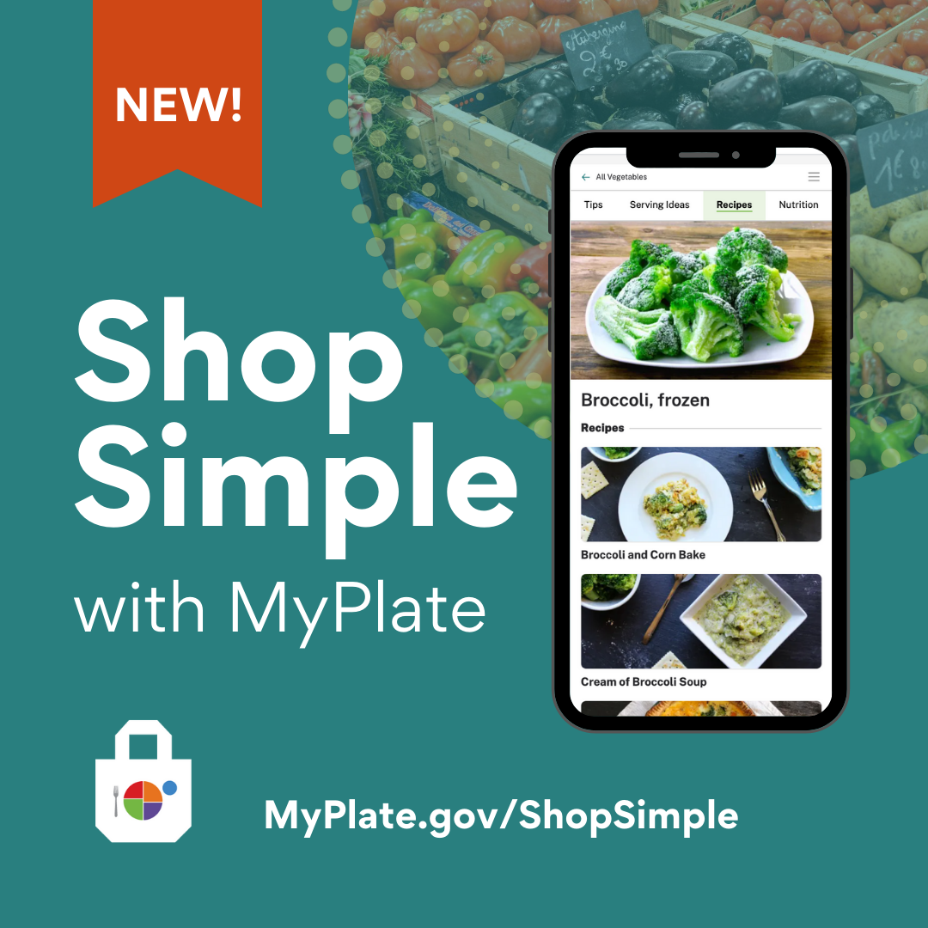
Notes:
Another resource that is available through the USDA is “Shop Simple with MyPlate”.
According to MyPlate.gov, “Shop Simple with MyPlate is a tool to help Americans save money while shopping for healthy food choices. Consumers can use this tool to quickly find savings in their local area and discover new ways to prepare budget-friendly foods”.
Source: https://www.myplate.gov/resources/graphics/promotional-images

Slide 13
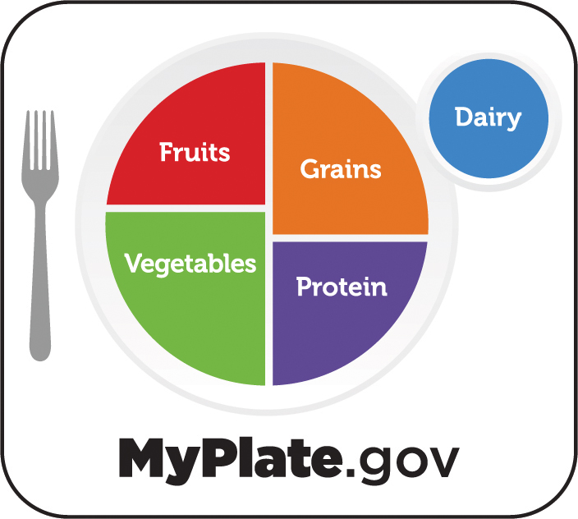
Notes:
Earlier we discussed the five food groups.
MyPlate, as shown on this slide, is considered the “official symbol of the five food groups”, and it serves as a reminder to include the right mix of foods with your meals.
MyPlate encourages us to balance our meals so that half of the plate includes fruits and vegetables, and the other half features a protein food and grain. A serving of dairy completes the meal.
This approach to eating is important at every stage of life and can have a positive effect on our health over time.
It’s also important to note that some meals will contain a mixture of foods from several food groups, so they may not be portioned out in this way. Or, the meal may be eaten out of a bowl.
For example, a casserole may include chicken with brown rice, broccoli, cauliflower, carrots and low-fat cheese. In this case, four of the five food groups are represented. Choosing a piece of fruit as a dessert would be a great way to make sure this food group is included, too.

Slide 14
Eat a variety of foods from all food groups.
Include your favorite cultural foods and traditions.
Eat foods in various forms including fresh, frozen, canned and dried.
Avoid fad diets that promote unnecessary restrictions.
Practice gratitude for your body by giving it the fuel it needs.
Notes:
Eating a variety of foods from all food groups will ensure you get the nutrients your body needs.
Including your favorite cultural foods and traditions can be an important part of a healthy eating routine. It allows you to adapt healthful eating recommendations to include foods which reflect your personal preferences and culture.
You can also eat foods in various forms, which can help keep food costs down. For example, when fresh produce is not in season, buying canned or frozen fruits and vegetables is a convenient way to include these foods. Remember to look for nutrient-dense forms, meaning those that have little added sugars, saturated fat, and sodium.
A healthy eating routine offers a variety of foods, so avoid fad diets that promote unnecessary restrictions.
Another important factor is to practice gratitude for your body by giving it the fuel it needs.

Slide 15

Make tasty foods at home.
Learn cooking and meal preparation skills.
Try new flavors and foods from around the world.
Find creative ways to use leftovers rather than tossing them.
Create happy memories by eating with friends and family when possible.
Notes:
How foods are prepared can also influence our eating habits and health. Make tasty foods at home by learning cooking and meal preparation skills. This will allow you to control the ingredients, as well as the amounts, that are used when preparing recipes.
For example, you can use healthier ingredients to flavor foods and beverages, such as fresh or dried herbs and spices instead of salt. And fruits offer a natural sweetness.
Try new flavors and foods from around the world as you plan your meals for the week.
Instead of eating the same foods every day or tossing them, find creative ways to use leftovers.
For instance, leftover grilled chicken could be shredded and eaten on salad, enjoyed in a wrap with veggies for lunch, or used to make soup.
Spending time in the kitchen and around the table will allow you to create happy memories. Try to make a point of eating with friends and family, when possible. This can even be done virtually.

Slide 16
Find a Nutrition Expert at
eatright.org
Notes:
Remember that a healthy eating routine is one that meets your unique needs.
There are many ways to eat healthfully while you Fuel for the Future.
For additional food and nutrition information and to find a nutrition expert in your area, visit eatright.org.

Slide 17
Questions?
Notes:
Are there any questions?

Slide 18
Thank You!

