Slide 1
2023年3月
National Nutrition Month®
NationalNutritionMonth.org
eatright.org
Notes:
Hello, my name is ___________________________, and I am a ________________________ (RDN, NDTR, intern, etc.).
I’m also a member of the Academy of Nutrition and Dietetics (Academy), the world’s largest organization of food and nutrition professionals.
Members of the Academy play a key role in shaping the public's food choices and are committed to improving the nation’s health.
As food and nutrition experts, registered dietitian nutritionists (RDNs) serve in roles that have a positive impact on the health of their patients, clients and communities. RDNs offer preventive and medical nutrition therapy services in a variety of settings, and they are a trusted source about what types of food to eat.
If you would like to improve your current eating habits and would benefit from personalized nutrition guidance, a registered dietitian nutritionist can help you develop a healthful eating plan that is as unique as you are.

Slide 2
2023年3月
NationalNutritionMonth.org
eatright.org
Notes:
Each year during March, we celebrate National Nutrition Month®, which is a nutrition education and information campaign sponsored by the Academy. It invites everyone to learn about making informed food choices and developing sound eating and physical activity habits.
National Nutrition Month® started in 1973 as National Nutrition Week, and it became a month-long observance in 1980 in response to growing interest in nutrition.
2023 will be its 50th anniversary, and the theme for this year’s National Nutrition Month® is Fuel for the Future.

Slide 3
目標：
列出食物中的營養素。
描述什麼使食物更營養豐富。
解釋在有限的預算下為未來加油的兩種方法。
Notes:
At the end of today’s presentation, you will be able to:
List the six types of nutrients found in foods.
Describe what makes a food nutrient-dense.
Explain two ways to “Fuel for the Future” on a limited budget.

Slide 4
營養素
碳水化合物
蛋白質
脂肪
維生素
礦物質
水
Notes:
There are six types of nutrients.
Does anyone know what they are?
Carbohydrates, proteins, fats, vitamins, minerals, and water.
Certain foods are known for being a good source of a particular nutrient but often the foods we eat include a mix of nutrients.
For example, fruits, like oranges, are a great source of vitamin C, but they are also a type of carbohydrate and provide water, along with other vitamins, including folate.
Choosing a variety of foods from each food group and within each food group is important, since no single food or food group provides all the nutrients we need for good health.

Slide 5
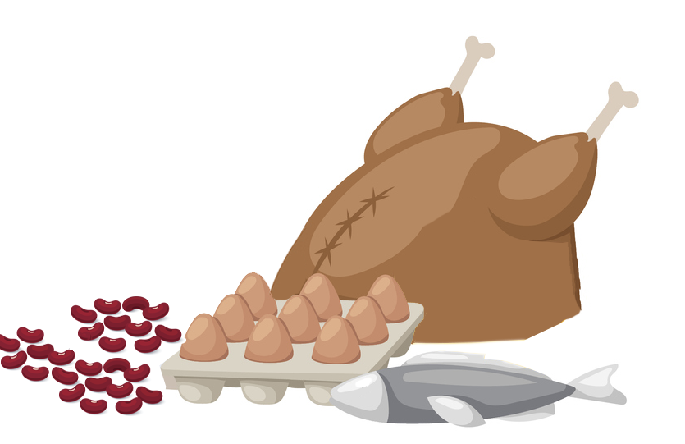
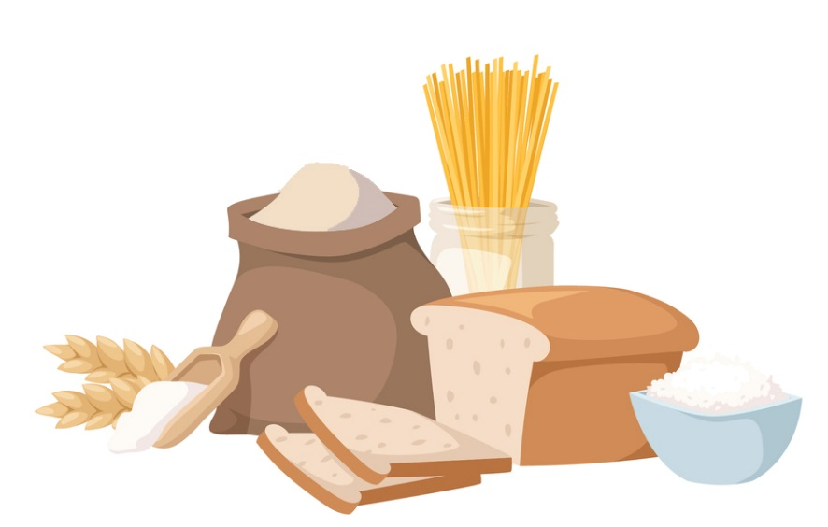
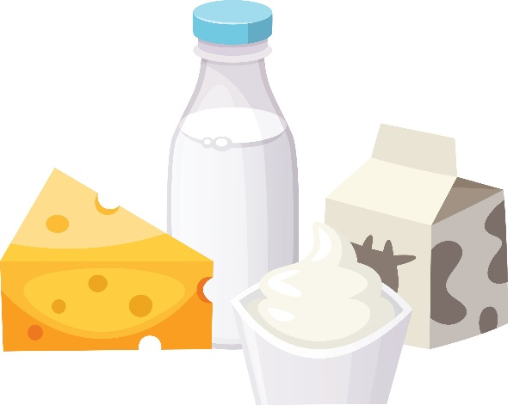
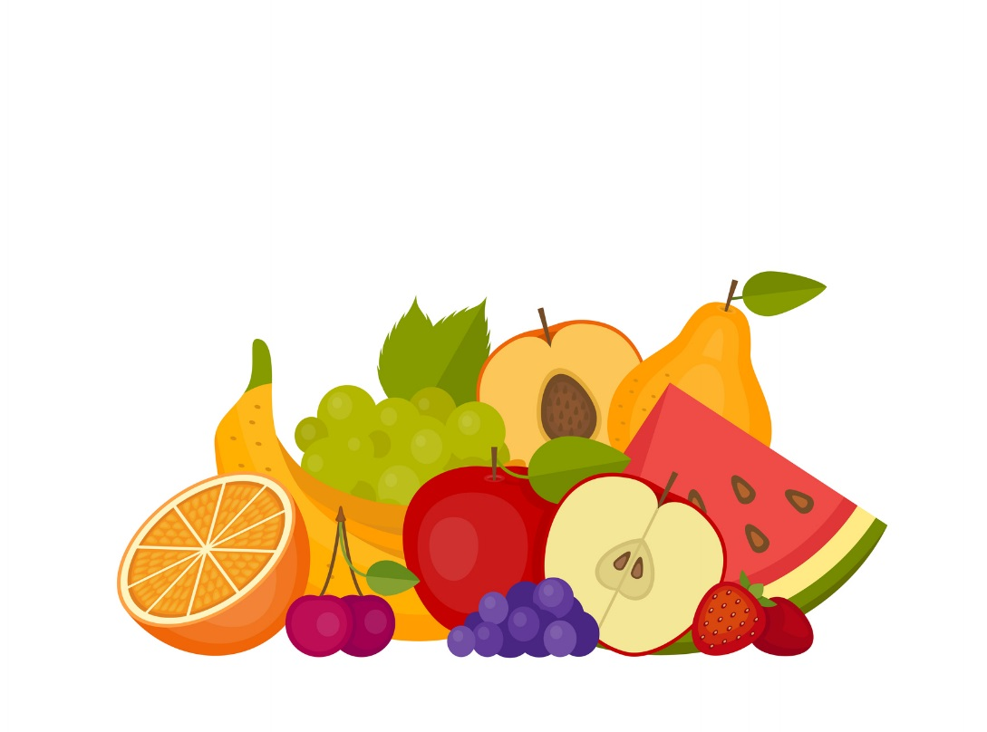
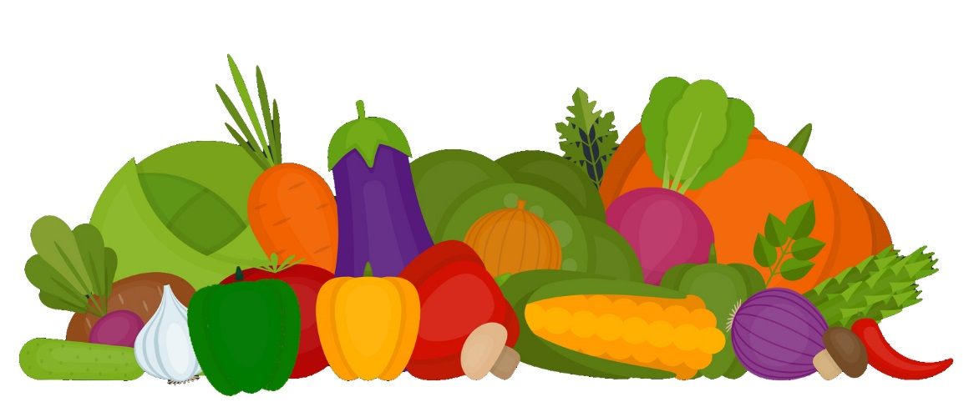
食物類別
Notes:
Who can tell me what the five food groups are?
The five food groups, as depicted on this slide, are: Dairy, Grains, Protein Foods, Vegetables, and Fruits.
Although we tend to choose foods and beverages based on factors, such as their taste, cost, and convenience, there are advantages to focusing on nutrient-dense forms.

Slide 6
營養豐富的食品和飲料提供維生素、礦物質和其他促進健康的成分，並且幾乎沒有添加糖、飽和脂肪和鈉。蔬菜、水果、全穀物、海產品、雞蛋、豆類、豌豆和扁豆、無鹽堅果和種子、無脂和低脂乳製品、瘦肉和家禽(在製作時不加或少加糖、飽和脂肪和鈉) 這些都是營養豐富的食物。
來源: U.S. Department of Agriculture and U.S. Department of Health and Human Services. Dietary Guidelines for Americans, 2020-2025. 9th Edition. December 2020. Available at DietaryGuidelines.gov.
Notes:
According to the 2020-2025 Dietary Guidelines for Americans, “Nutrient-dense foods and beverages provide vitamins, minerals, and other health-promoting components and have little added sugars, saturated fat, and sodium. Vegetables, fruits, whole grains, seafood, eggs, beans, peas, and lentils, unsalted nuts and seeds, fat-free and low-fat dairy products, and lean meats and poultry—when prepared with no or little added sugars, saturated fat, and sodium— are nutrient-dense foods”
A healthy eating routine, includes a variety of nutrient-dense foods and in the recommended amounts from each food group.
No matter your age or activity level, making healthful food and drink choices will provide your body with energy now and Fuel for the Future.

Slide 7
為未來加油
吃飯時要考慮到環境問題。
約見註冊營養師（RDN）。
保持營養，並節省開支。
進食所有的食物類別中的各種食物。
在家製作可口的食物。
Notes:
These are a few says that we can Fuel for the Future:
Eat with the environment in mind.
See a Registered Dietitian Nutritionist (RDN).
Stay nourished and save money.
Eat a variety of foods from all food groups.
Make tasty foods at home.

Slide 8
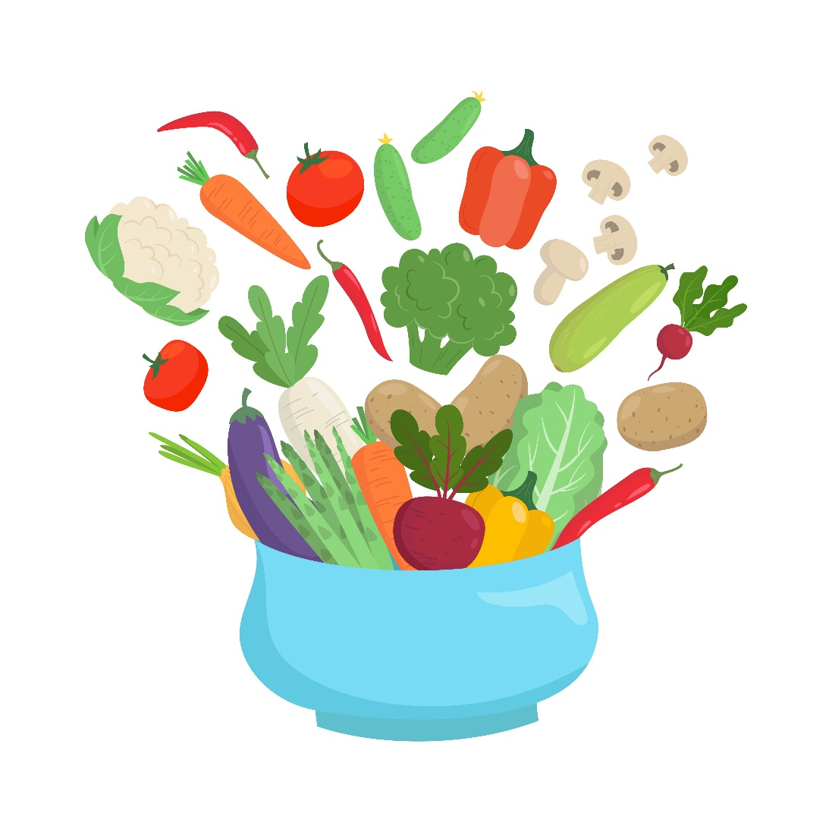
吃飯時要考慮到環境問題。
享用更多植物性膳食和零食。
購買包裝最少的食品。
盡可能購買時令食品並在當地購物。
在家裡開一個容器或利用後院花園來種植食物。
Notes:
Ways to eat with the environment in mind include:
Enjoying more foods that come from plants, like fruits, vegetables, grains, nuts and seeds.
Purchasing foods with minimal packaging, such as buying items in bulk.
Buying foods that are in season and shopping locally when possible. One example would be buying produce from a farmers market.
You can also consider growing food at home by starting a garden in a container or backyard.

Slide 9
約見註冊營養師（RDN）。
請你的醫生為你轉介到註冊營養師(RDN)。
尋找一個專門針對你的獨特需求的註冊營養師(RDN)。
了解營養素需求如何隨著年齡的增長而變化。
獲得個人化的營養資訊以滿足你的健康目標。
Notes:
Another way to Fuel for the Future is to see a registered dietitian nutritionist, also known as an RDN.
RDNs are the nutrition experts and can provide sound, easy-to-follow personalized nutrition advice.
Ask your doctor for a referral to an RDN, then find an RDN who specializes in your unique needs.
By seeing an RDN, you can learn how nutrient needs may change with age and receive personalized nutrition information to meet your health goals.

Slide 10
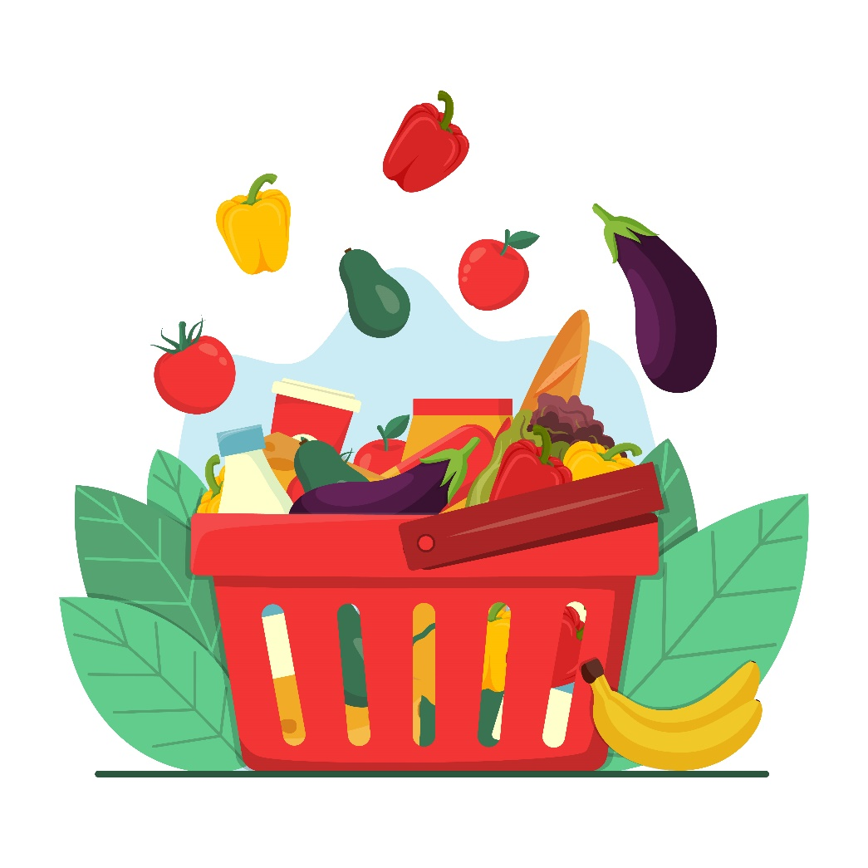
保持營養，並節省開支。
計劃你的膳食和零食。
在購買更多的食物之前，先看看你家裡有什麼食物。
在購買食品時，請使用購物清單並選購商店促销產品。
了解社區資源，例如補充營養援助計劃(SNAP)、婦女、嬰兒和兒童計劃(WIC) 和當地食品銀行。
Notes:
RDNs can also help you to stay nourished and save money while fueling for the future.
Planning your meals and snacks is a great place to start. It’s not only a habit that will help you eat healthfully, but it can also save you money and reduce wasted food.
Start by seeing what foods you have at home, then use a grocery list to shop sales when purchasing the foods you need.
You can also learn about resources in your community, such as SNAP, WIC, and local food banks.
These types of programs offer food assistance to individuals who are eligible.

Slide 11
營養計劃
補充營養援助計劃(SNAP)
SNAP 提供電子資金，幫助家庭獲得維持健康飲食所必需的食物。這包括水果、蔬菜、蛋白質食品、乳製品、麵包和穀類食品等。資格取決於家庭收入和有限的資源。
有關如何申請的說明，請聯絡你所在州的 SNAP 辦公室。
婦女、嬰兒和兒童特別補充營養計劃(WIC)
WIC 旨在為有營養風險的孕婦、產後和哺乳期婦女以及處於營養風險中的嬰兒和五歲以下兒童提供服務。還必須符合家庭收入要求。計劃參與者有資格獲得補充食品和營養教育。WIC 也可以與其他政府計劃結合使用，例如補充營養援助計劃(SNAP)、全國學校早餐計劃(NSB) 和全國學校午餐計劃(NSLP)。聯絡你所在州的WIC機構，以尋找離你最近的地點進行申請。
來源: https://www.fns.usda.gov/programs
Notes:
For example, the Supplemental Nutrition Assistance Program, also known as SNAP, provides assistance to individuals who qualify so that nutritious foods, including fruits, vegetables, protein foods, dairy products, breads and cereals can be purchased.
WIC is another type of program that offers supplemental foods and nutrition education to eligible individuals who are pregnant and breastfeeding and their children up until the age of five.
Please keep in mind that these are only two examples of federal nutrition programs that are offered through the Food and Nutrition Service of the U.S. Department of Agriculture and a brief description of each.
More information is available on the USDA’s website: https://www.fns.usda.gov/programs.

Slide 12
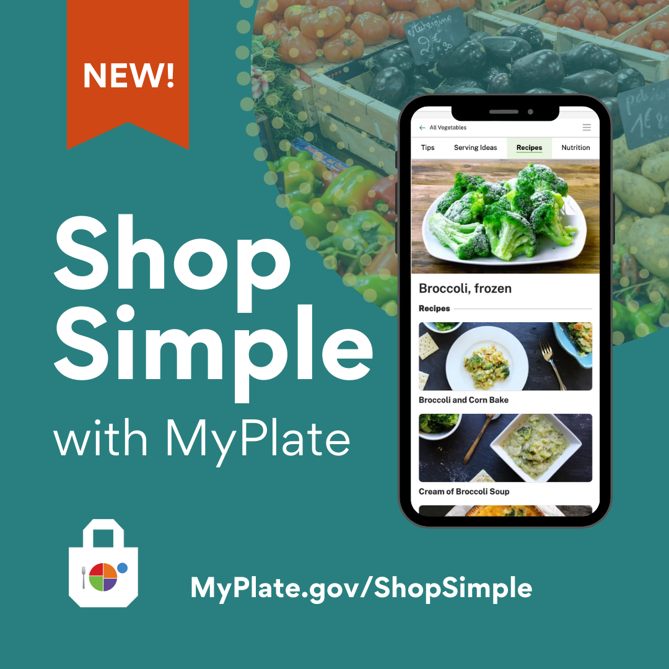
Notes:
Another resource that is available through the USDA is “Shop Simple with MyPlate”.
According to MyPlate.gov, “Shop Simple with MyPlate is a tool to help Americans save money while shopping for healthy food choices. Consumers can use this tool to quickly find savings in their local area and discover new ways to prepare budget-friendly foods”.
Source: https://www.myplate.gov/resources/graphics/promotional-images

Slide 13
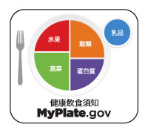
Notes:
Earlier we discussed the five food groups.
MyPlate, as shown on this slide, is considered the “official symbol of the five food groups”, and it serves as a reminder to include the right mix of foods with your meals.
MyPlate encourages us to balance our meals so that half of the plate includes fruits and vegetables, and the other half features a protein food and grain. A serving of dairy completes the meal.
This approach to eating is important at every stage of life and can have a positive effect on our health over time.
It’s also important to note that some meals will contain a mixture of foods from several food groups, so they may not be portioned out in this way. Or, the meal may be eaten out of a bowl.
For example, a casserole may include chicken with brown rice, broccoli, cauliflower, carrots and low-fat cheese. In this case, four of the five food groups are represented. Choosing a piece of fruit as a dessert would be a great way to make sure this food group is included, too.

Slide 14
進食所有的食物類別中的各種食物。
將你喜愛的文化食物和傳統融為一體。
食用各種形態的食物，包括新鮮的、冷凍的、罐裝的和乾製食品。
避免那些提倡不必要限制的時尚飲食法。
為你的身體提供所需的能量，以此來表達你對身體的感激之情。
Notes:
Eating a variety of foods from all food groups will ensure you get the nutrients your body needs.
Including your favorite cultural foods and traditions can be an important part of a healthy eating routine. It allows you to adapt healthful eating recommendations to include foods which reflect your personal preferences and culture.
You can also eat foods in various forms, which can help keep food costs down. For example, when fresh produce is not in season, buying canned or frozen fruits and vegetables is a convenient way to include these foods. Remember to look for nutrient-dense forms, meaning those that have little added sugars, saturated fat, and sodium.
A healthy eating routine offers a variety of foods, so avoid fad diets that promote unnecessary restrictions.
Another important factor is to practice gratitude for your body by giving it the fuel it needs.

Slide 15
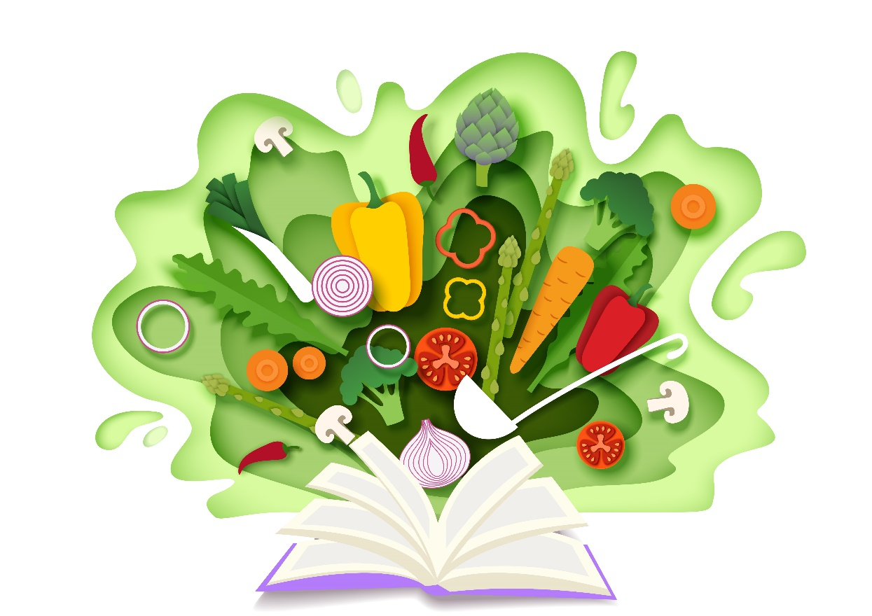
在家製作可口的食物。
學習烹飪和備餐的技巧。
嘗試來自世界各地的風味和食物。
找到新穎的方法來使用剩菜剩飯，而不是把它們扔掉。
盡可能與朋友和家人一起吃飯，創造快樂的回憶。
Notes:
How foods are prepared can also influence our eating habits and health. Make tasty foods at home by learning cooking and meal preparation skills. This will allow you to control the ingredients, as well as the amounts, that are used when preparing recipes.
For example, you can use healthier ingredients to flavor foods and beverages, such as fresh or dried herbs and spices instead of salt. And fruits offer a natural sweetness.
Try new flavors and foods from around the world as you plan your meals for the week.
Instead of eating the same foods every day or tossing them, find creative ways to use leftovers.
For instance, leftover grilled chicken could be shredded and eaten on salad, enjoyed in a wrap with veggies for lunch, or used to make soup.
Spending time in the kitchen and around the table will allow you to create happy memories. Try to make a point of eating with friends and family, when possible. This can even be done virtually.

Slide 16
尋找營養專家，請瀏覽
eatright.org
Notes:
Remember that a healthy eating routine is one that meets your unique needs.
There are many ways to eat healthfully while you Fuel for the Future.
For additional food and nutrition information and to find a nutrition expert in your area, visit eatright.org.

Slide 17
問題？
Notes:
Are there any questions?

Slide 18
謝謝!

